Slide 1
Definition:-
Academic activity tracking system helps teachers to mark online attendance of students during class & reduce manual work. It is used to track student's attendance, absent record, assignment, question bank, exam, attendance history & other related documents.

Slide 2
purpose:-
Academic activity tracking system records and maintains student's attendance data using smart devices.
The system collects attendance records in the system and manages, stores and processes the data.
It generates daily attendance reports that help the faculty to track student's presence with high accuracy and efficiency.
If also generate assignment, question bank and exam.

Slide 3
Key features:-
For Admin:-
Maintain course, semester, subject etc.
Maintain lecture information
Get different types of attendance reports on one click
For Teacher:-
Maintain student attendance
Assignment Assign for students
Manage MCQ Question bank
Online MCQ exam
For Student:-
View Attendance
Detail Attendance
Submit Assignment
Submit MCQ Exam

Slide 4
Hardware Requirement:-
AMD RYZEN 3 3250U Processor
8.00 GB RAM
64-bit operating system, x64-based processor
Software requirement:-
Font End:-
HTML
CSS
JAVASCRIPT
PHP
Back End:-
MYSQL
Tools:-
Wampserver

Slide 5
modules:-
Admin Module:-
Admin can manage course.
Admin can manage semester.
Admin can manage subject.
Admin can manage teacher.
Admin can manage Allotment subject semester wise.
Admin can show different types of data.
Teacher Module:-
Teacher can manage Attendance like insert,update.
Teacher can manage lecture information.
Teacher can generate Assignment.
Teacher can generate question bank.
Student’s Module:-
Student’s can view attendance reports.
Student’s can submit assignment.
Student’s can give the exam online.

Slide 6
scope of project:-
Implementing secure login and role-based access for admin, teachers,Students.
When admin login is capable for handling all the web page information i.e., Course Entry Page, Semester Entry Page, Subject Entry Page, Lecturer Entry Page, Subject allotment Entry Page, Generate Roll number.
When lecturer login is capable for making entry of attendance of Students, manage the lectures information and manage the assignment and exam questions.
Objectives:-
Admin can handle all the web page easily to manage.
Teacher can easily manage attendance, assignment, exam for students.
Students can show the attendance, assignment and question bank.

Slide 7
Data Flow Diagram

Slide 8

$$ZERO LEVEL DFD :−$$
Event
Management
System
ADMIN
LOGIN INFO
LOGIN INFO
ORGANISER
ACCESS TO SYSTEM
ACCESS TO SYSTEM
ACCESS TO
SYSTEM
LOGIN
INFO
USER

Slide 9

$1^{ST} LEVEL DFD:$-
USER
Languages
Categories
Registration
Events
Events
Organization info.
1.0
Registration
Process
2.0
Login
Process
3.0
Master
Entry
Processs
4.0
Manage
Events
5.0
User
Activity
6.0
Profile
Events
transactions
ADMIN
ORGANISER

Slide 10
$$2^{nd} LEVEL DFD for 3.0 \left(Master Entry Process\right):−$$
3.1
MANAGE
EVENTS
EVENT INFO
EVENT INFO
EVENTS DETAIL
EVENT DETAIL
EVENT DETAIL
CATEGORIES INFO
3.2
MANAGE
CATEGO-RIES
CATEGORIES INFO
CATEGORIES DETAIL
CATEGORIES DETAIL
CATEGORIES DETAIL
ADMIN
LANGUAGES INFO
3.3
MANAGE
LANGUA-GES
LANGUAGES INFO
SUBJECT DETAIL
LANGUAGES DETAIL
LANGUAGES DETAIL
ORGANISATIONS INFO
3.4
MANAGE
ORGANI-
SATIONS
ORGANISATIONS INFO
ORGANISATIONS DETAIL
ORGANISATIONS DETAIL
ORGANISATIONS DETAIL
CANCEL EVENTS INFO
3.5
MANAGE
CANCEL
EVENTS
CANCEL EVENTS INFO
CANCEL EVENTS DETAIL
CANCEL EVENTS DETAIL
CANCEL EVENTS DETAIL

Slide 11
$$2^{nd} LEVEL DFD for 4.0\left(Manage Events\right):−$$
EVENT INFO
4.1
CREATE
EVENT
EVENT INFO
EVENT DETAIL
EVENT DETAIL
EVENT INFO
4.2
UPDATE
EVENT
EVENT INFO
ORGANISER
EVENT DETAIL
EVENT DETAIL
EVENT DETAIL
EVENT INFO
4.3
DELETE
EVENT
EVENT INFO
EVENT DETAIL
EVENT DETAIL

Slide 12
$$2^{nd} LEVEL DFD for 5.0\left(User Activity\right):−$$
EVENTS INFO
5.1
VIEW
EVENT
INFO.
EVENTS INFO
EVENTS DETAIL
EVENTS DETAIL
EVENT INFO
5.2
ENROLL
IN EVENT
EVENT INFO
USER
EVENTS DETAIL
EVENT DETAIL
EVENT DETAIL
EVENT INFO
5.3
CANCEL
EVENT
ENROLL.
EVENT INFO
EVENT DETAIL
EVENT DETAIL

Slide 13
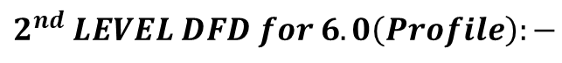
$$2^{nd} LEVEL DFD for 6.0\left(Profile\right):−$$
PROFILE INFO
6.1
VIEW PROFILE
DETAIL
PROFILE INFO
PROFILE DETAIL
PROFILE DETAIL
PROFILE INFO
6.2
UPDATE
PROFILE
DETAIL
PROFILE INFO
ADMIN/
ORGANISER
PROFILE DETAIL
PROFILE DETAIL
PROFILE DETAIL

Slide 14
Login details:-
File name | Data type | Length | Constraint | Null | Description
Userid | Int | 10 | - | Not Null | Username
password | Varchar | 20 | - | Not Null | Password

Slide 15
Course Details:-
File name | Data type | Length | Constraint | Null | Description
course_id | Int | 3 | Primary key | Not null | Auto increment
course_name | Varchar | 50 | - | Not null | Course name
course_type | Varchar | 10 | - | Not null | Course type
course_sem | Varchar | 10 | - | Not null | Course wise Number of semester

Slide 16
Semester details:-
File name | Data type | Length | Constraint | Null | Description
sem_id | Int | 3 | Primary Key | Not Null | Auto increment
sem_name | Varchar | 20 | - | Not Null | Semester name

Slide 17
Subject details:-
File name | Data type | Length | Constraint | Null | Description
sub_id | int | 3 | Primary Key | Not Null | Auto increment
course_id | int | 3 | Foreign Key | Not Null | Refrence from course
sem_id | int | 3 | Foreign Key | Not Null | Refrence from semester
sub_code | Varchar | 20 | - | Not Null | Subject code
sub_name | Varchar | 40 | - | Not Null | Subject name

Slide 18
Designation:-
File name | Data type | Length | Constraint | Null | Description
des_id | Int | 3 | Primary Key | Not Null | Auto increment
des_name | Varchar | 20 | - | Not Null | Designation name

Slide 19
Teacher:-
File name | Data type | Length | Constraint | Null | Description
t_id | Int | 3 | Primary Key | Not Null | Auto increment
u_type | Varchar | 20 | - | Not Null | Admin or teacher
fname | Varchar | 40 | - | Not Null | First name
mname | Varchar | 40 | - | Not Null | Middle name
lname | Varchar | 40 | - | Not Null | Last name
gender | Varchar | 20 | - | Not Null | Gender
dob | Date |  | - | Not Null | Date of Birth
qulification | Varchar | 40 | - | Not Null | Qulification
des_id | Varchar | 40 | Foreign Key | Not Null | Reference from designation
doj | Date |  | - | Not Null | Date of join
contact | Varchar | 10 | - | Not Null | Contact
email | Varchar | 40 | - | Not Null | Email
password | Varchar | 40 | - | Not Null | Password

Slide 20
Subject allotment:-
File name | Data type | Length | Constraint | Null | Description
sa_id | Int | 3 | Primary Key | Not Null | Auto increment
course_id | Int | 3 | Foreign Key | Not Null | Course table
sem_id | Int | 3 | Foreign Key | Not Null | Semester table
sub_id | Int | 3 | Foreign Key | Not Null | Subject table
t_id | Int | 3 | Foreign Key | Not Null | Teacher table
academic_year | Varchar | 20 | - | Not Null | Academic year

Slide 21
Lecture information:-
File name | Data type | Length | Constraint | Null | Description
lec_id | Int | 3 | Primary Key | Not Null | Auto increment
lec_date | Date |  | - | Not Null | Lecture of date
course_id | Int | 3 | Foreign Key | Not Null | Course table
sem_id | Int | 3 | Foreign Key | Not Null | Semester table
lec_no | Int | 20 | - | Not Null | Lecture of number
po_status | Varchar | 30 | - | Not Null | Proxy lecture or not
sub_id | Int | 3 | Foreign Key | Not Null | Subject table
t_id | Int | 3 | Foreign Key | Not Null | Teacher table
lec_topic | Varchar | 50 | - | Not Null | Topic of lecture
lec_method | varchar | 50 | - | Not Null | Method of lecture

Slide 22
Students attendance:-
File name | Data type | Length | Constraint | Null | Description
lec_id | Int | 3 | Foreign Key | Not Null | Lecture information table
s_id | Int | 3 | Foreign Key | Not Null | Student table
p_flag | Varchar | 1 | - | Not Null | Present and Absent

Slide 23
Students restration:-
File name | Data type | Length | Constraint | Null | Description
s_id | Int | 3 | Primary Key | Not Null | Auto increment
s_fn | Varchar | 20 | - | Not Null | Student First Name
s_mn | Varchar | 40 | - | Not Null | Student Middle Name
s_ln | Varchar | 20 | - | Not Null | Student Last Name
dob | Date |  | - | Not Null | Date of birth
gender | Varchar | 10 | - | Not Null | Gender
address | Varchar | 50 | - | Not Null | Address
gr_no | Varchar | 10 | - | Not Null | General register number
en_no | Varchar | 10 | - | Not Null | Enrollment number
contact | Varchar | 10 | - | Not Null | Contact
parents_contact | Varchar | 10 | - | Not Null | Parents contact
email | Varchar | 40 | - | Not Null | Email
password | Varchar | 40 | - | Not Null | Password
roll_no | Int | 5 | - | Not Null | Roll number
approval_status | Boolean |  | - | Not Null | Approval Status
course _id | Int | 3 | Foreign Key | Not Null | Course Table
sem_id | Int | 3 | Foreign Key | Not Null | Semester Table

Slide 24
assignment:-
File name | Data type | Length | Constraint | Null | Description
assign_id | Int | 3 | Primary Key | Not Null | Auto increment
course_id | Int | 3 | Foreign Key | Not Null | Course table
sem_id | Int | 3 | Foreign Key | Not Null | Semester table
sub_id | Int | 3 | Foreign Key | Not Null | Subject table
assign_date | Date | - | - | Not Null | Assignment date
submi_date | Date | - | - | Not Null | Submission date
assign_topic | Varchar | 300 | - | Not Null | Assignment topic
t_id | Int | 3 | Foreign Key | Not Null | Teacher table

Slide 25
Exam:-
File name | Data type | Length | Constraint | Null | Description
e_id | Int | 3 | Primary Key | Not Null | Auto increment
course_id | Int | 3 | Foreign Key | Not Null | Course table
sem_id | Int | 3 | Foreign Key | Not Null | Semester table
sub_id | Int | 3 | Foreign Key | Not Null | Subject table
date | Date | - | - | Not Null | Exam date

Slide 26
Question:-
File name | Data type | Length | Constraint | Null | Description
que_id | Int | 3 | Primary Key | Not Null | Auto increment
course_id | Int | 3 | Foreign Key | Not Null | Course table
sem_id | Int | 3 | Foreign Key | Not Null | Semester table
sub_id | Int | 3 | Foreign Key | Not Null | Subject table
que | Varchar | 100 | - | Not Null | Question
oa | Varchar | 50 | - | Not Null | Option A
ob | Varchar | 50 | - | Not Null | Option B
oc | Varchar | 50 | - | Not Null | Option C
od | Varchar | 50 | - | Not Null | Option D
ans | Varchar | 50 | - | Not Null | Answer
t_id | Int | 3 | Foreign Key | Not Null | Teacher table

Slide 27
Student submission:-
File name | Data type | Length | Constraint | Null | Description
as_id | Int | 3 | Primary Key | Not Null | Auto increment
assign_id | Int | 3 | Foreign Key | Not Null | Assignment id
s_id | Int | 3 | Foreign Key | Not Null | Student id
sub_date | Date |  | - | Not Null | Submission date
assignment_file | Varchar | 50 | - | Not Null | Assignment file (pdf)
marks | Int | 3 | - | Not Null | Marks

Slide 28
Admin Side

Slide 29
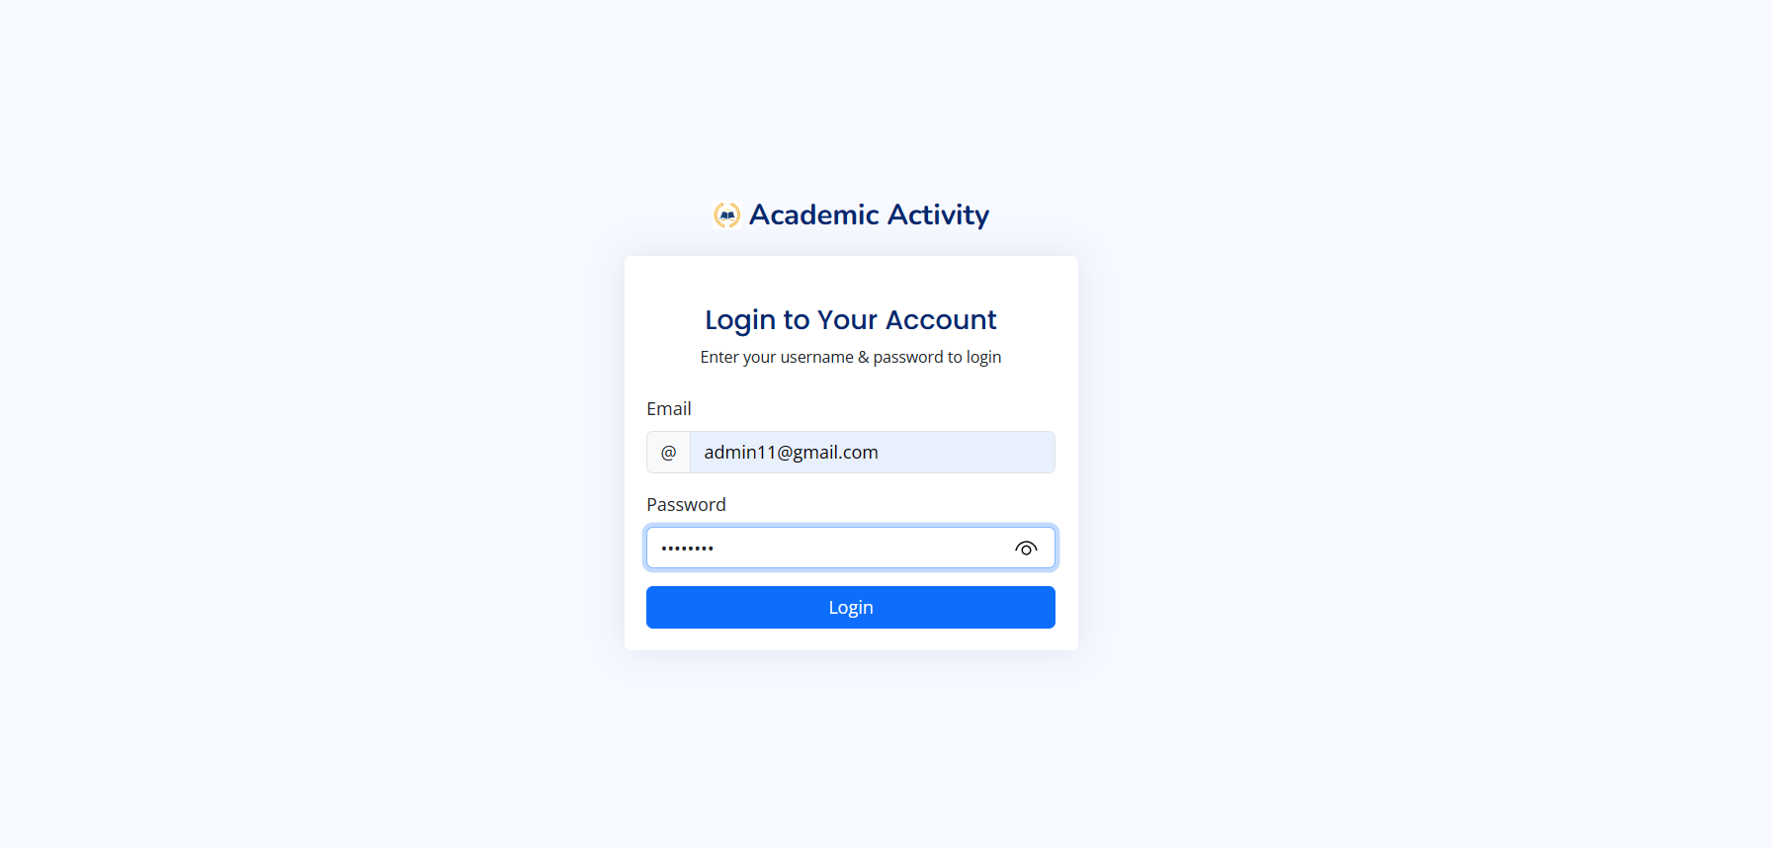

Slide 30
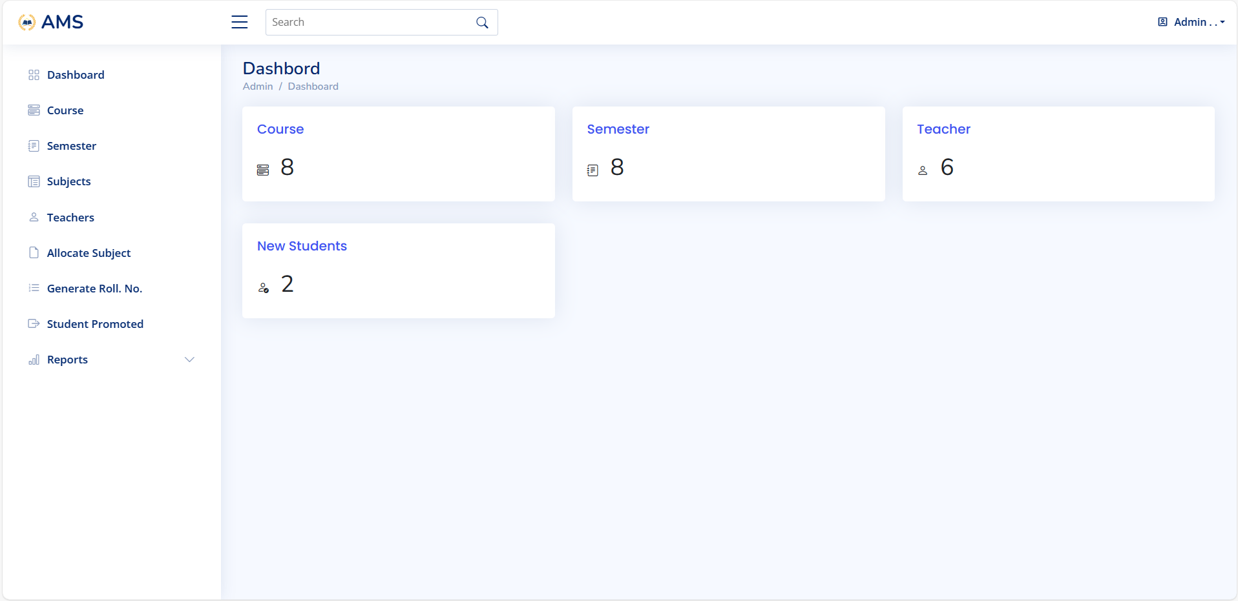

Slide 31
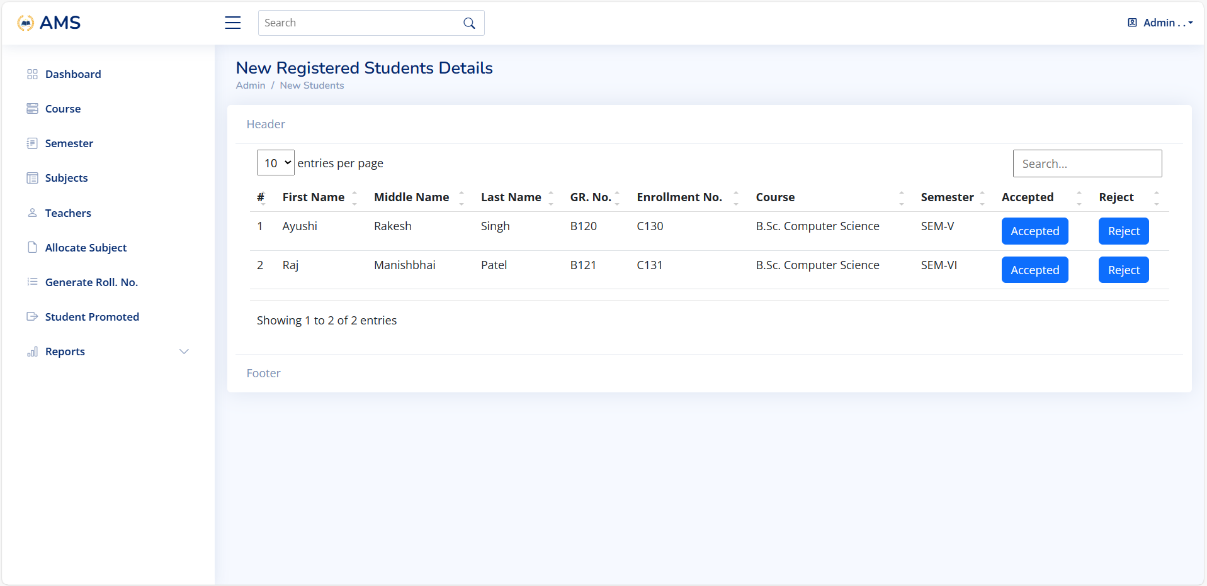

Slide 32
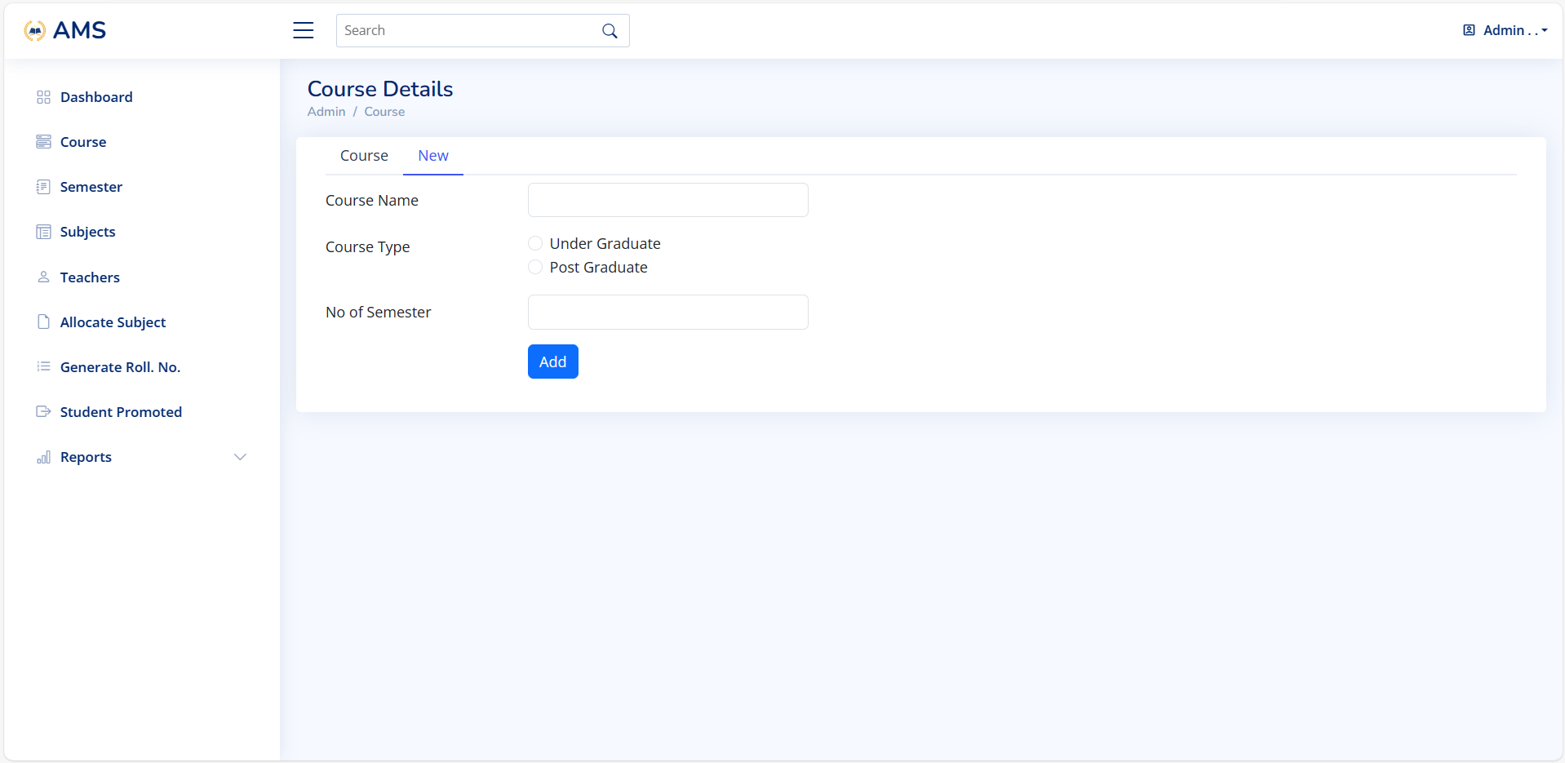

Slide 33
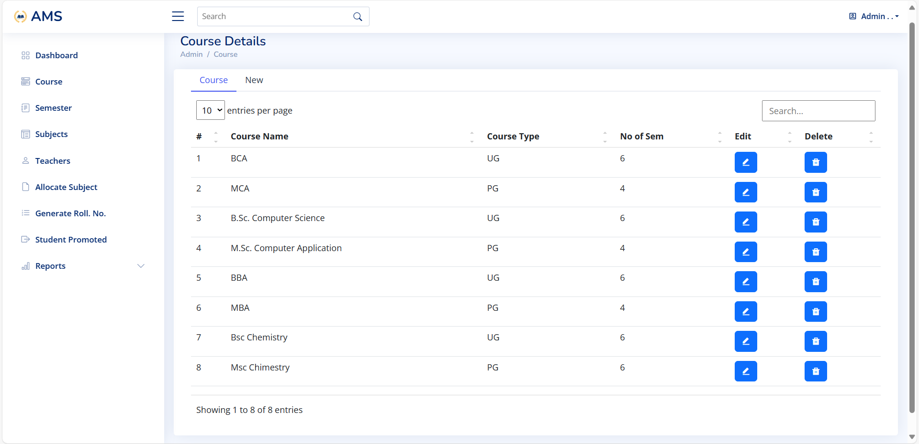

Slide 34
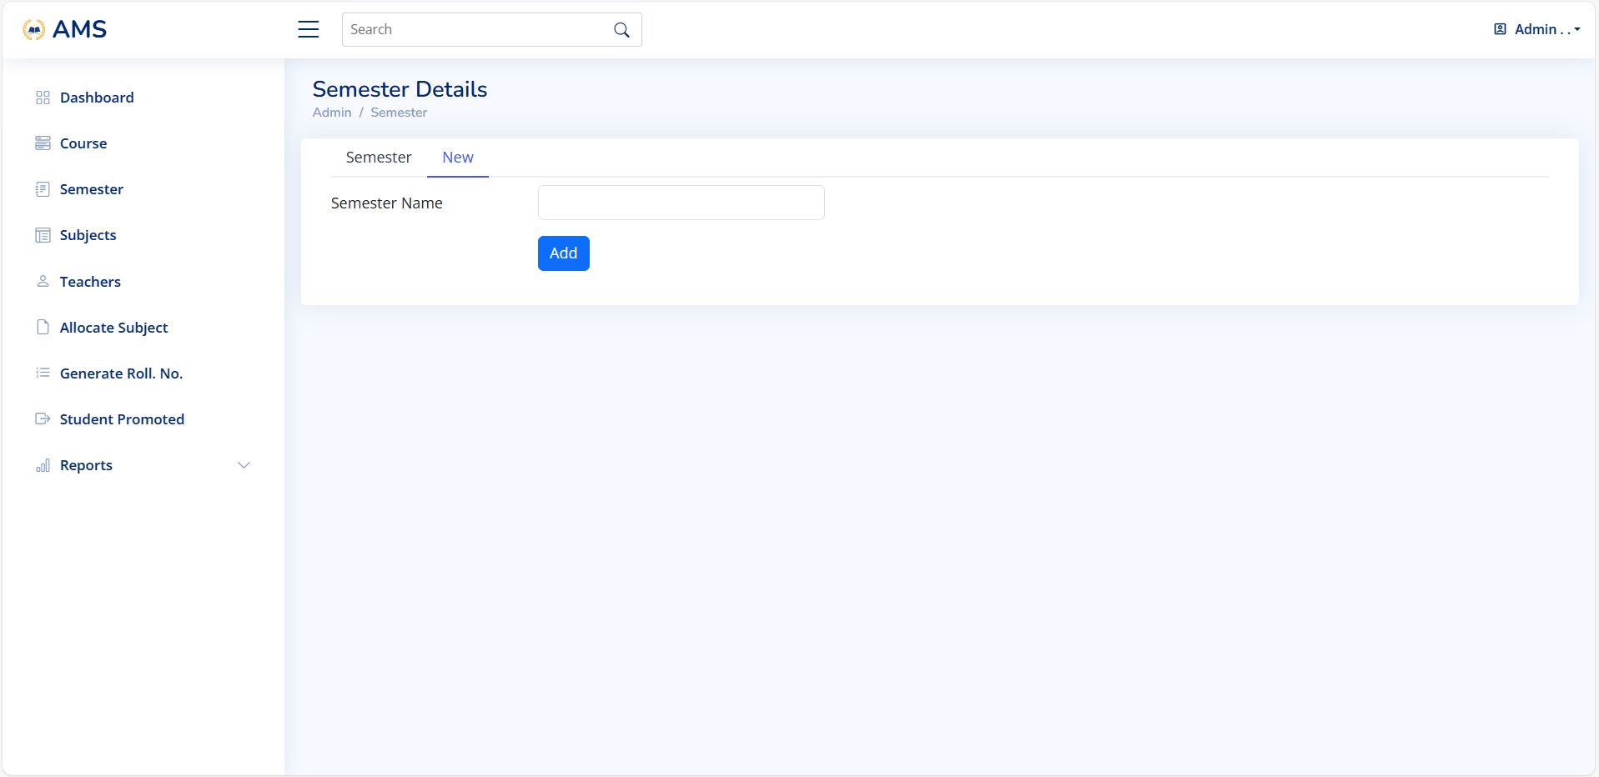

Slide 35
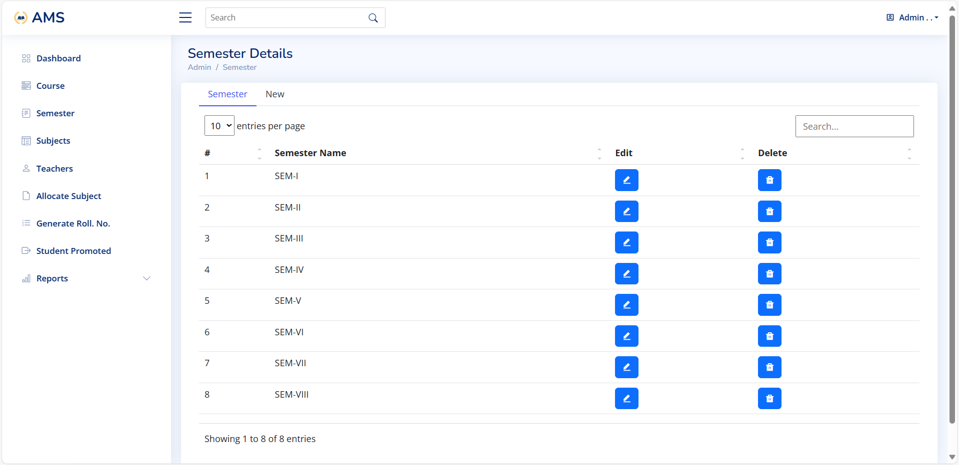

Slide 36
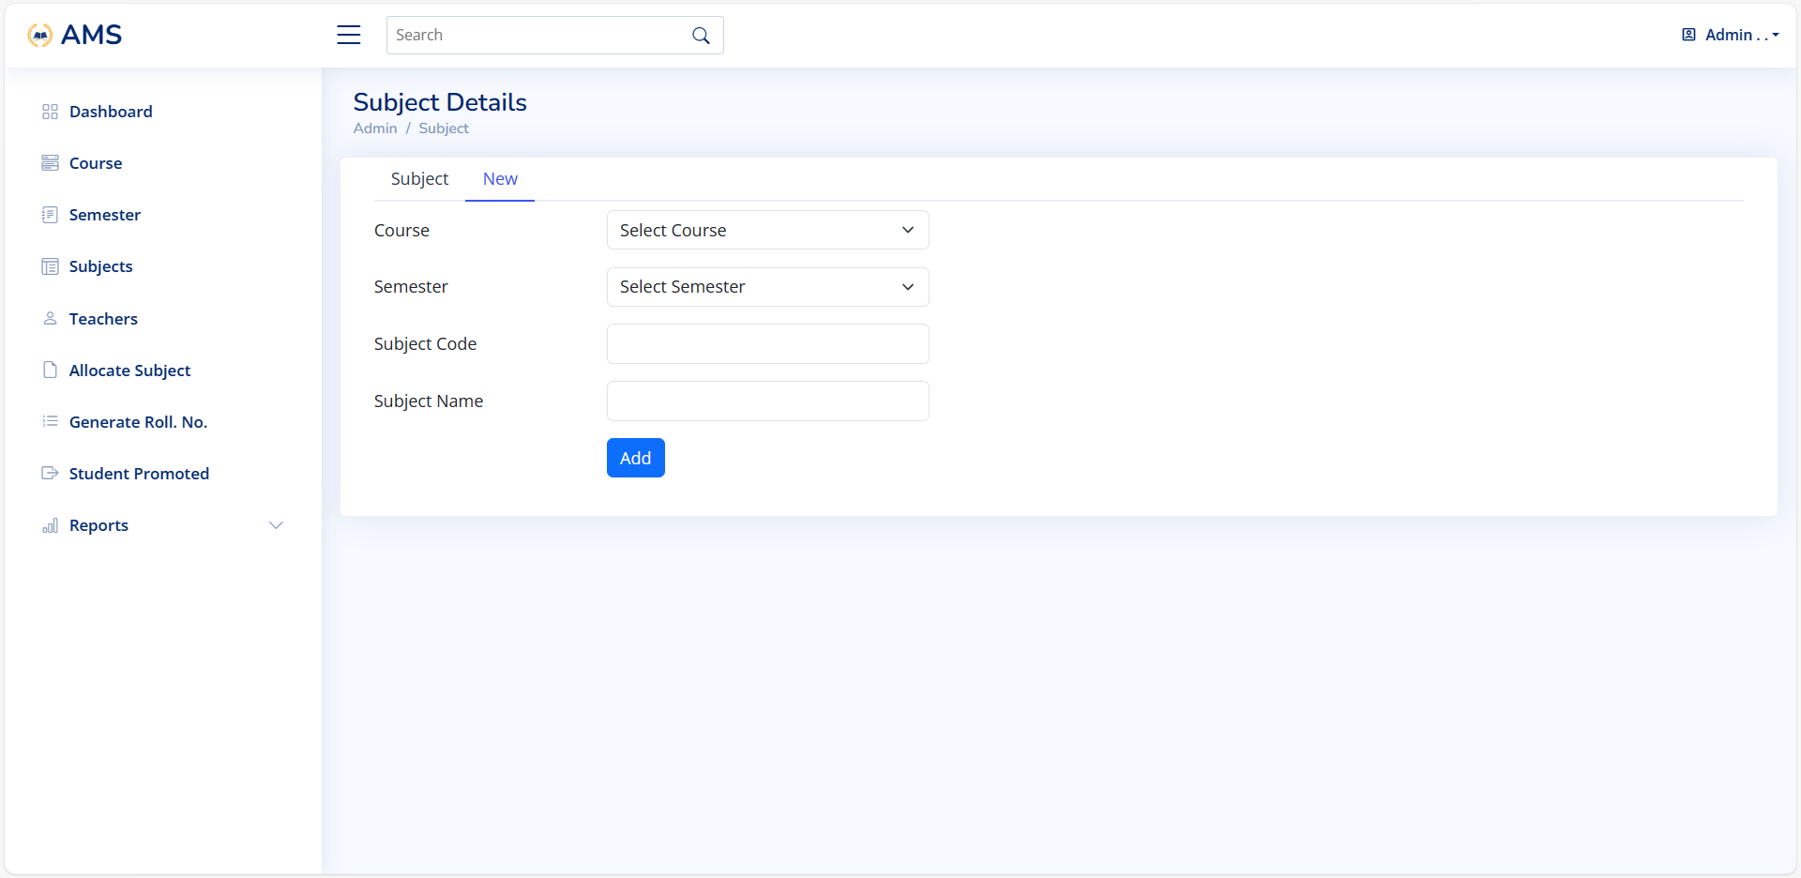

Slide 37
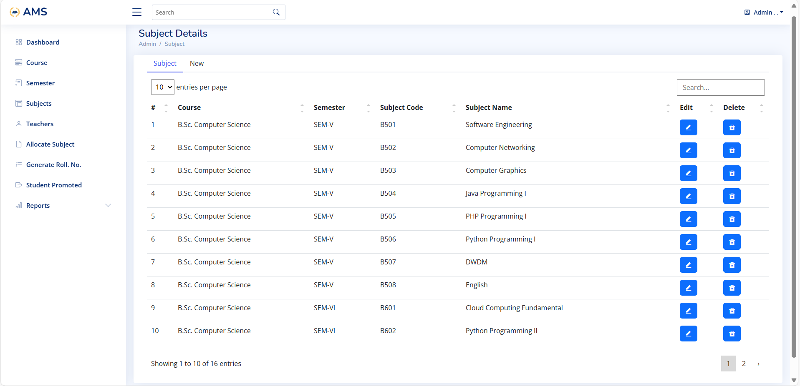

Slide 38
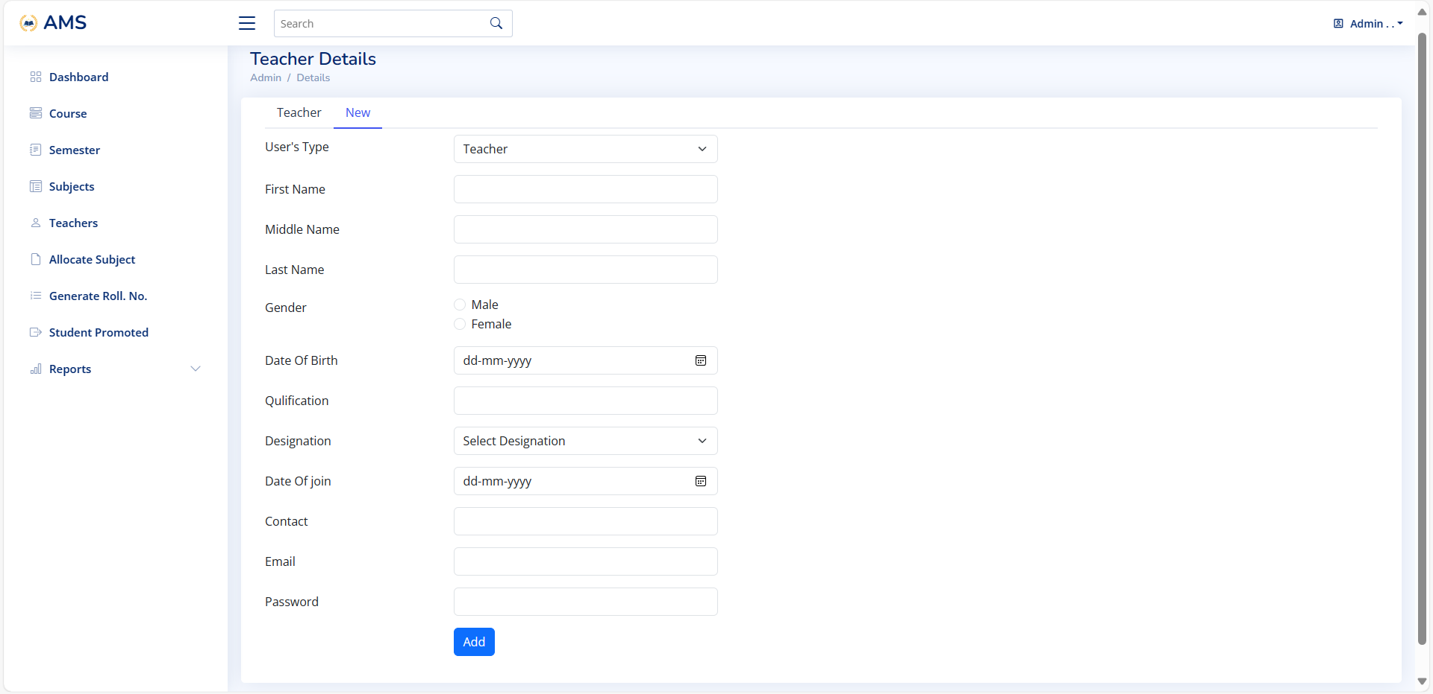

Slide 39
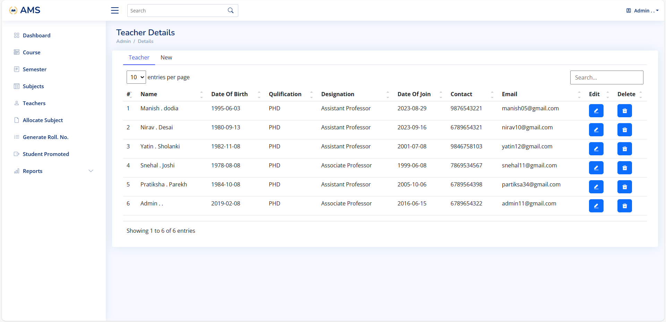

Slide 40
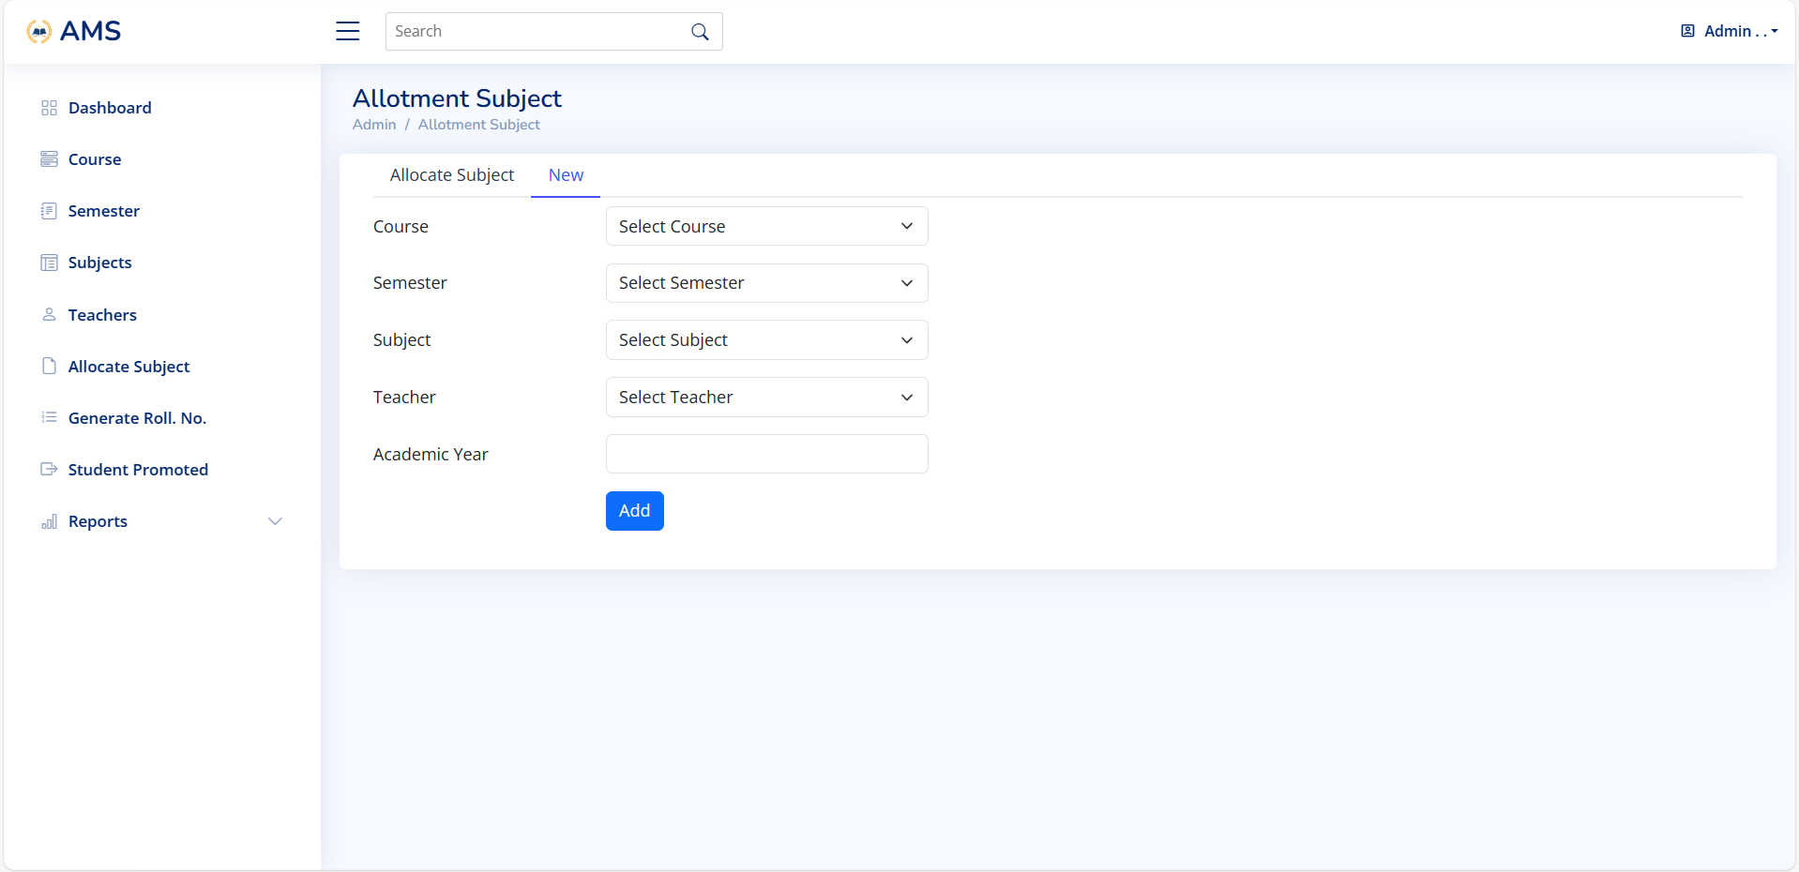

Slide 41
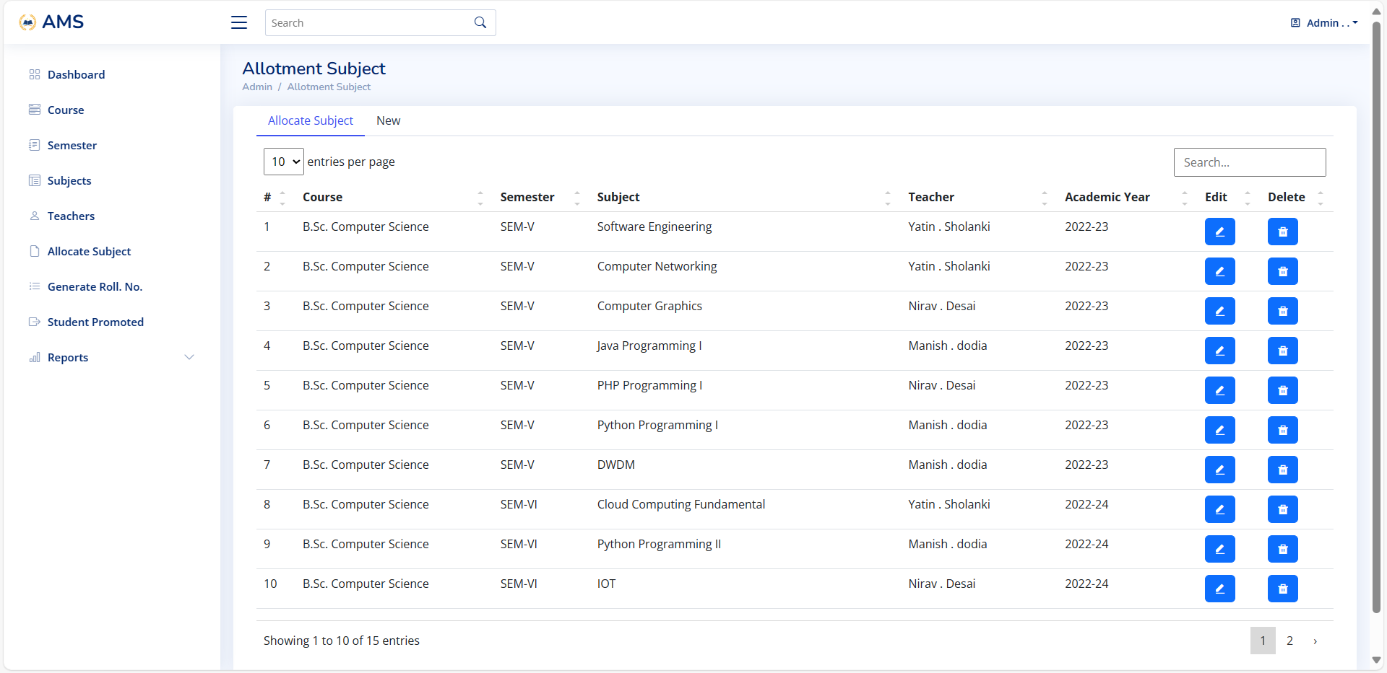

Slide 42
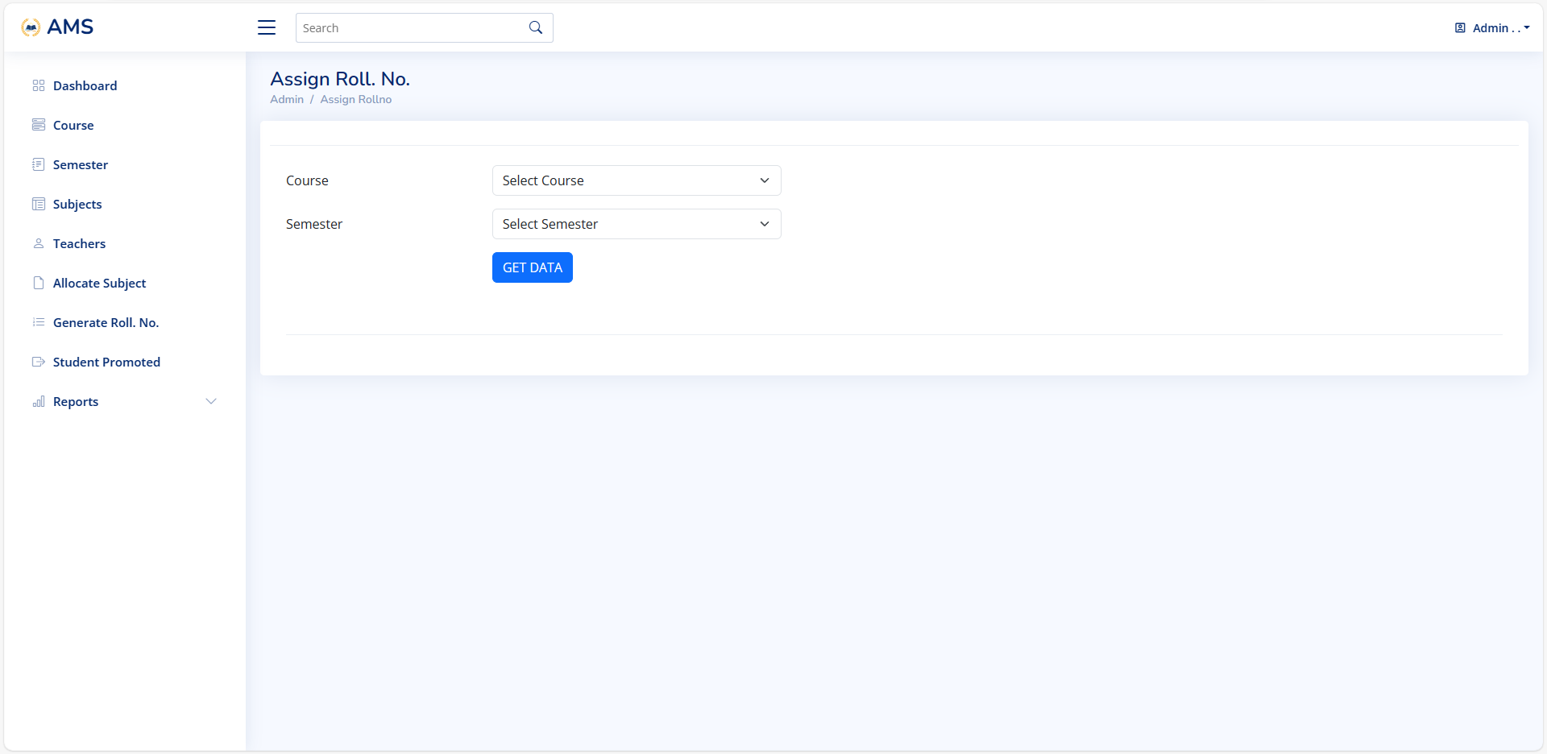

Slide 43
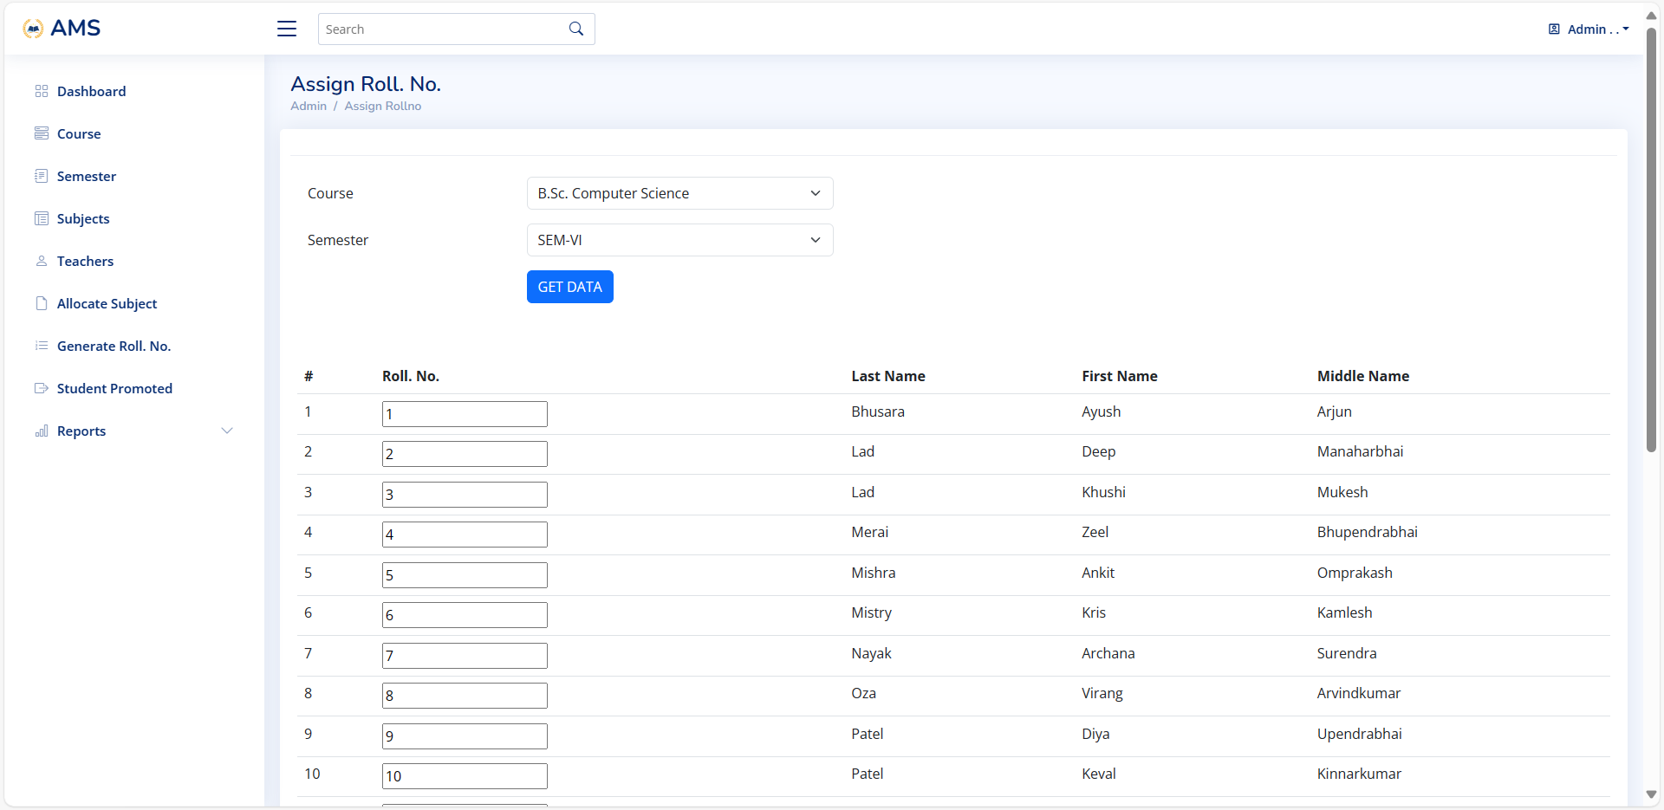

Slide 44
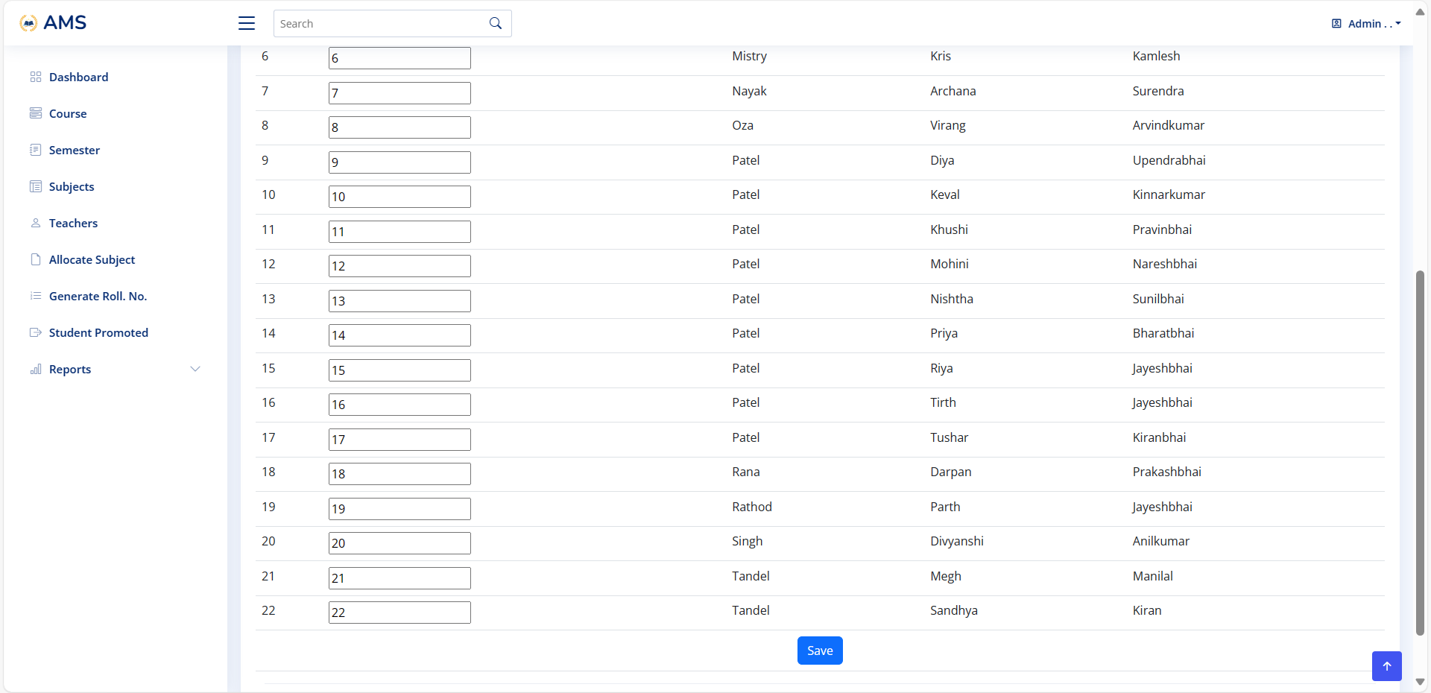

Slide 45
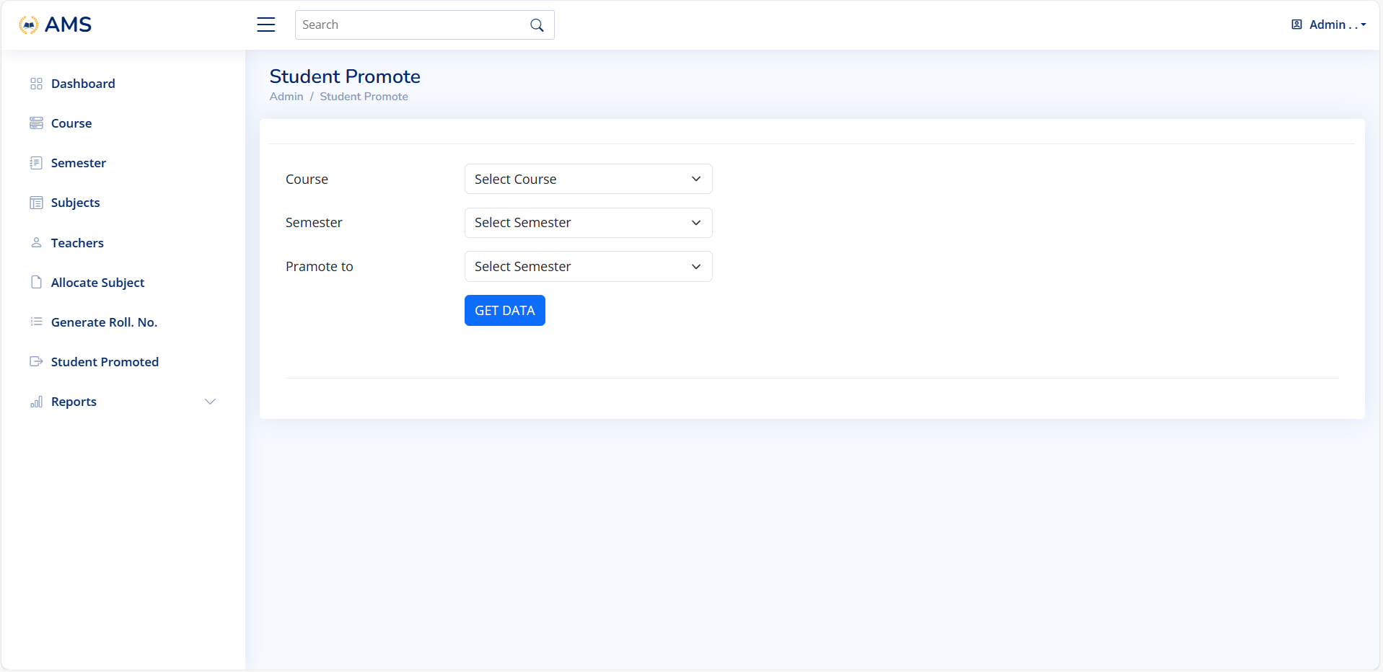

Slide 46
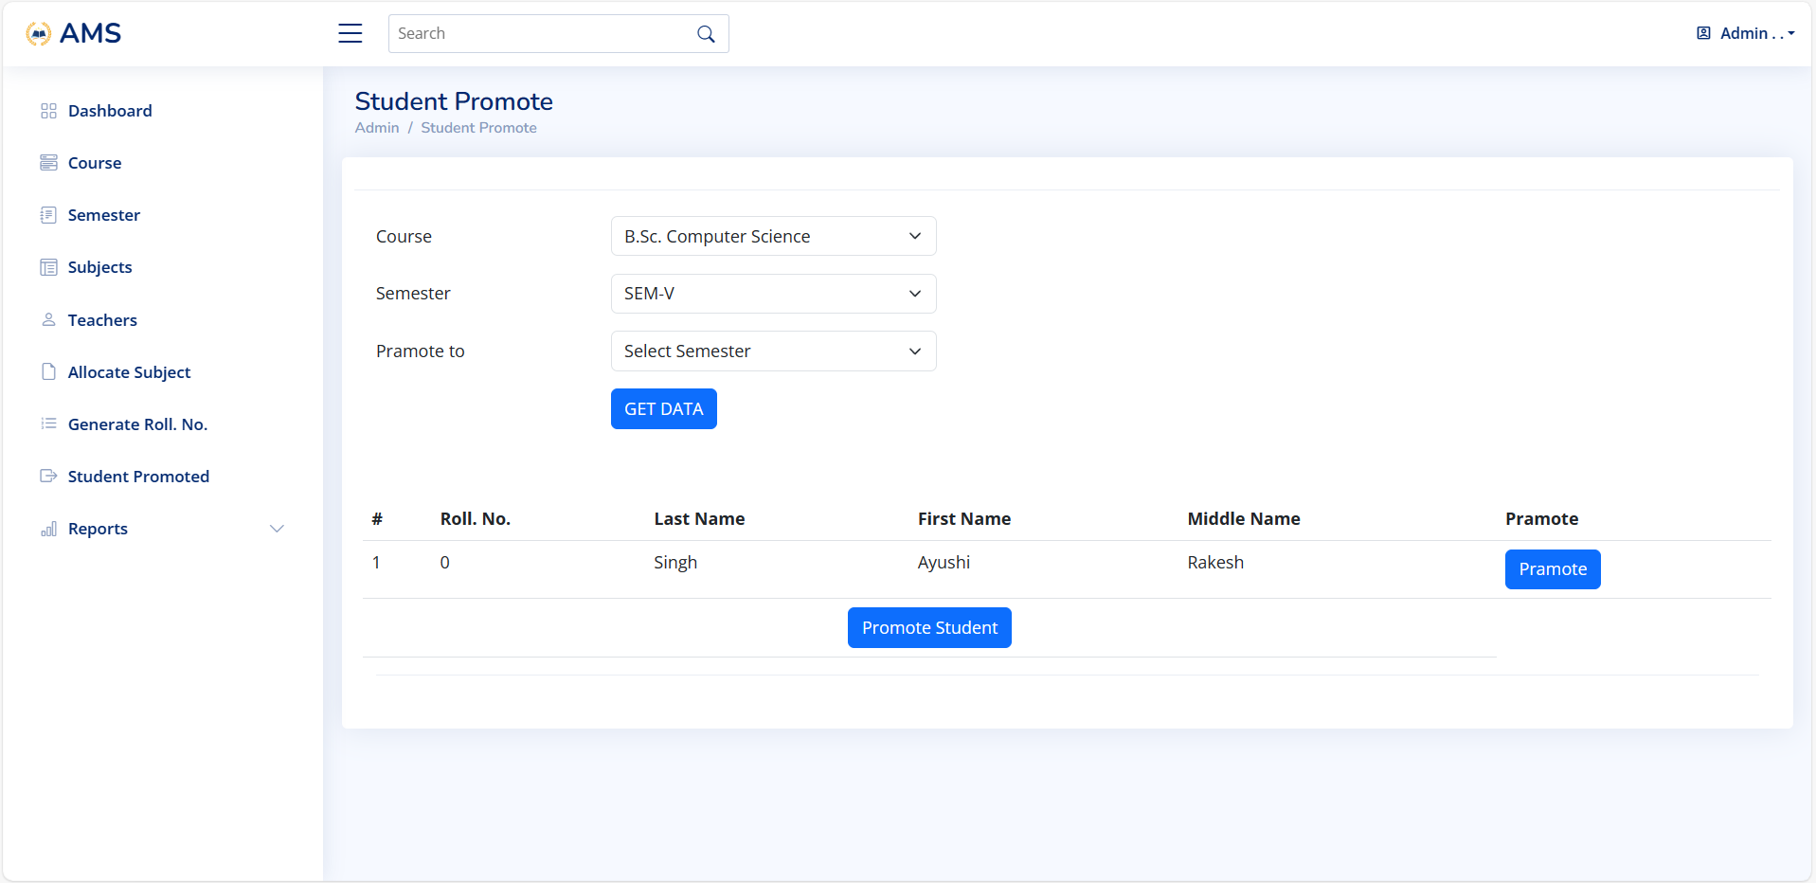

Slide 47
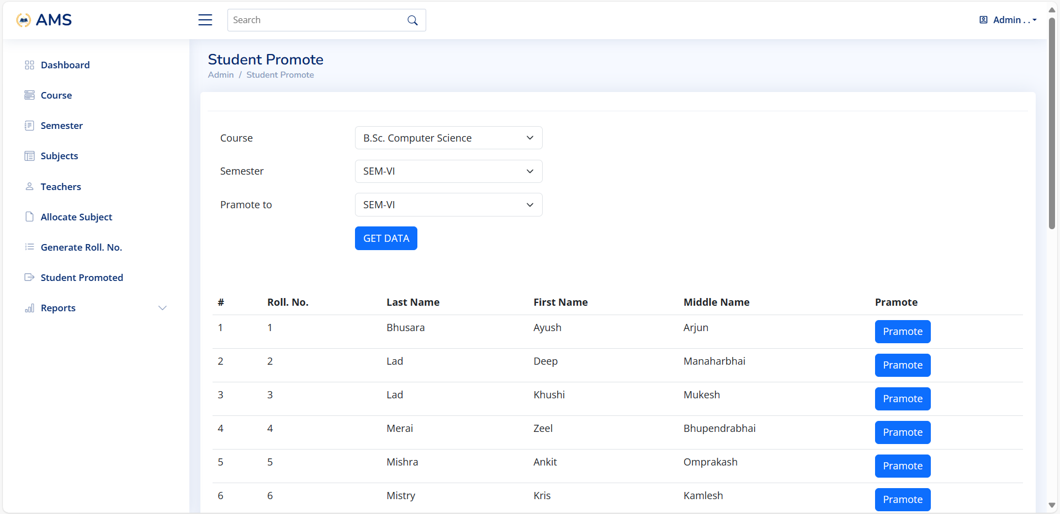

Slide 48
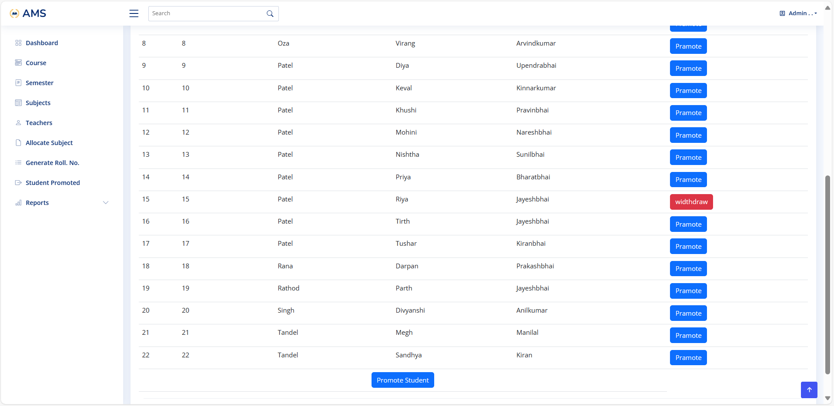

Slide 49
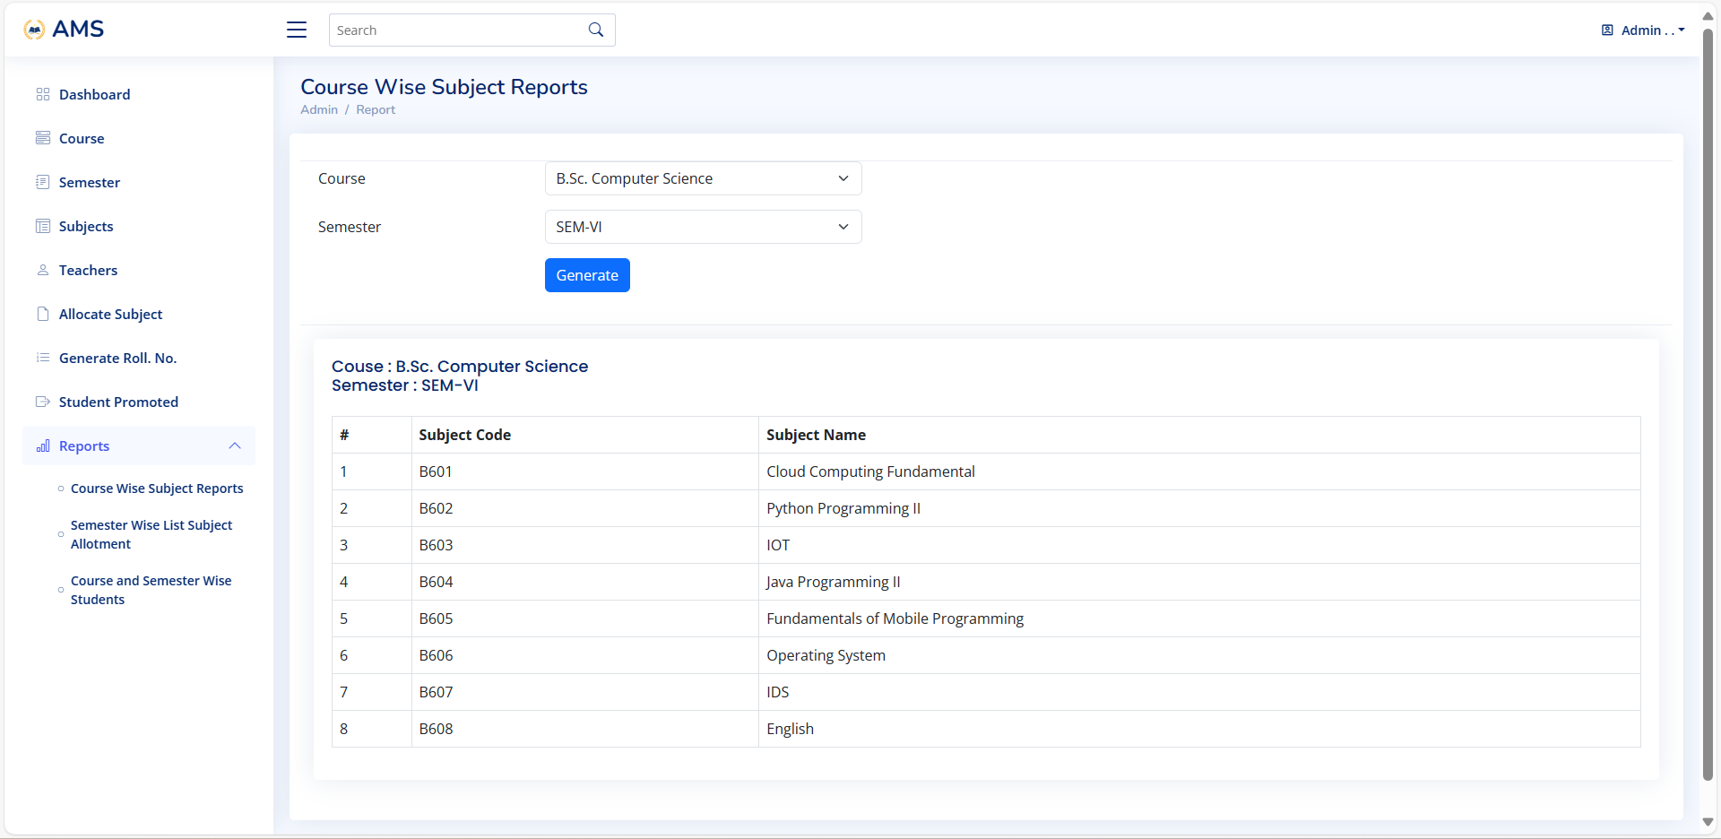

Slide 50
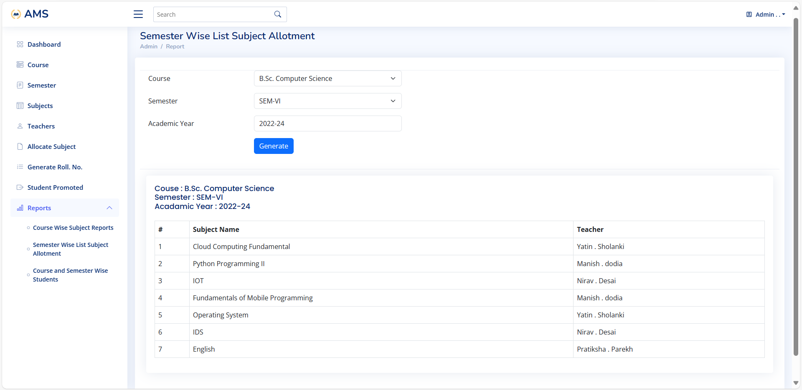

Slide 51
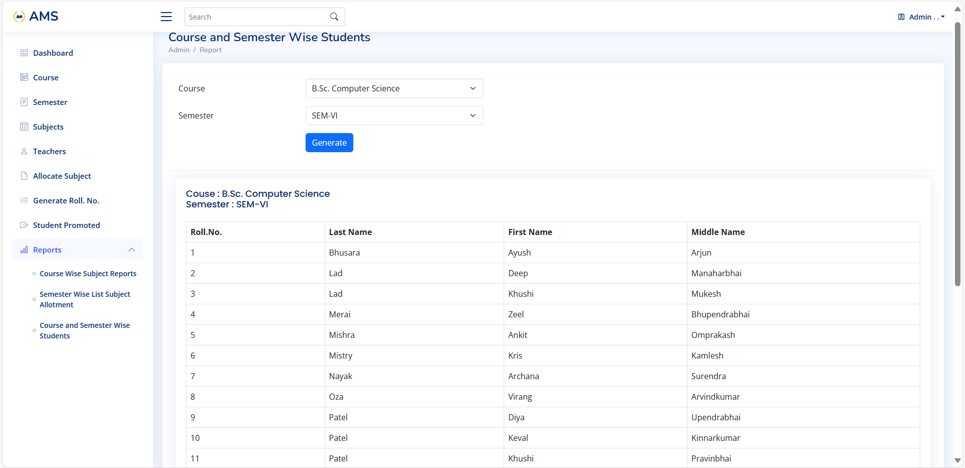

Slide 52
Teacher Side

Slide 53


Slide 54
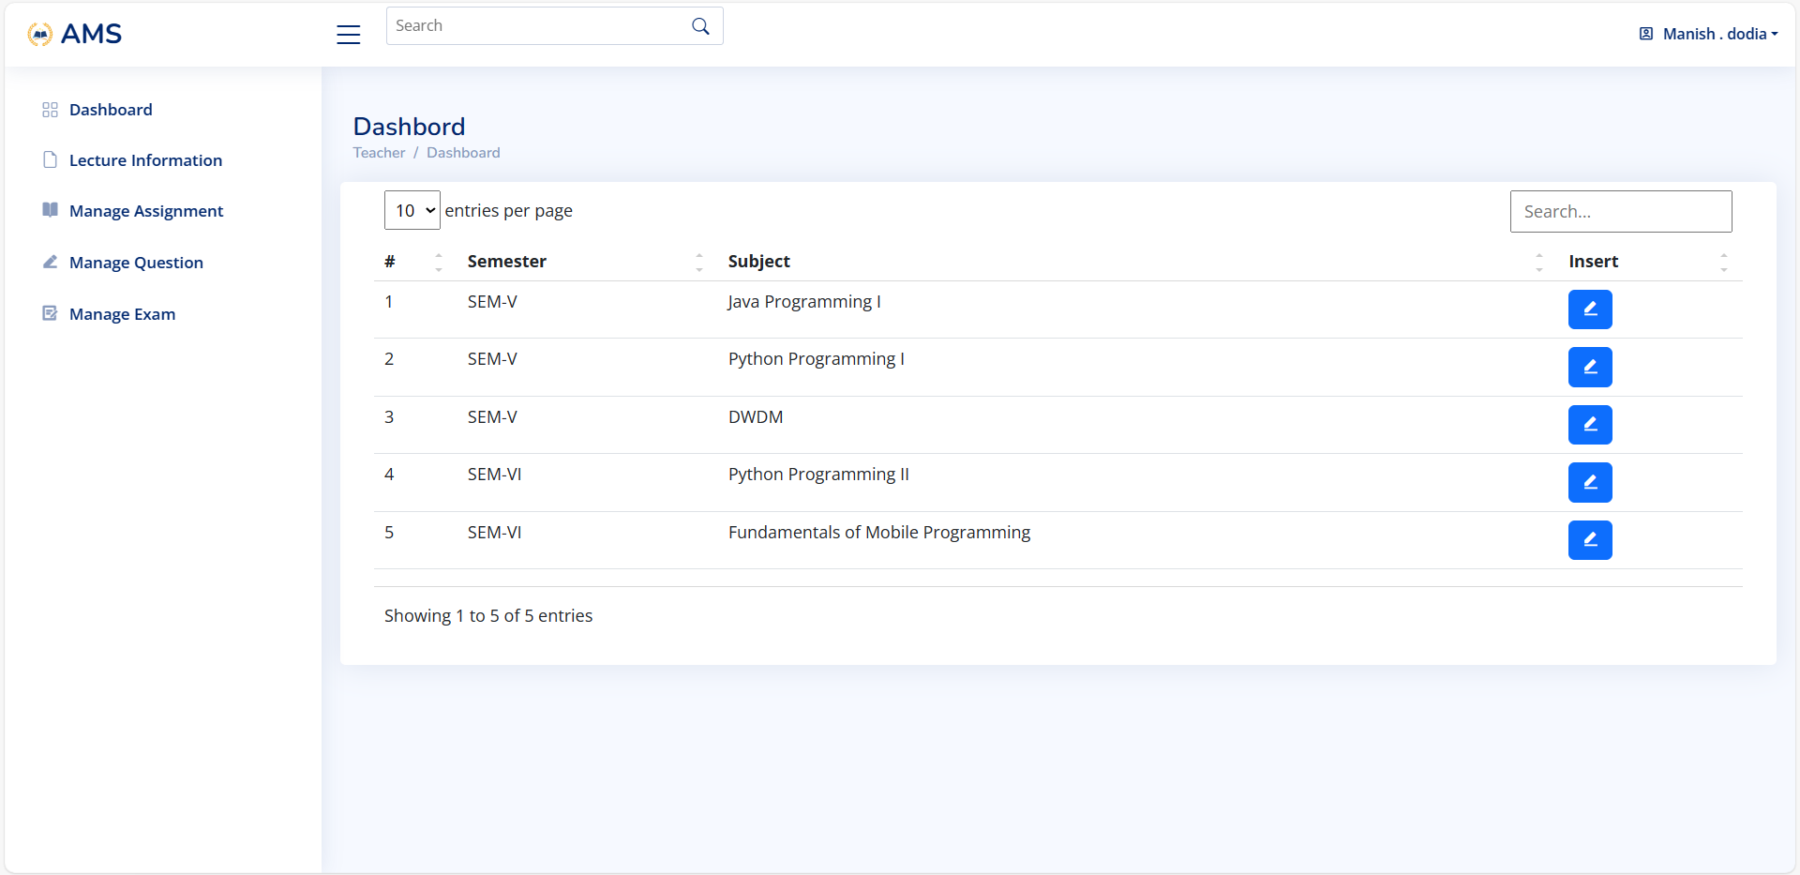

Slide 55
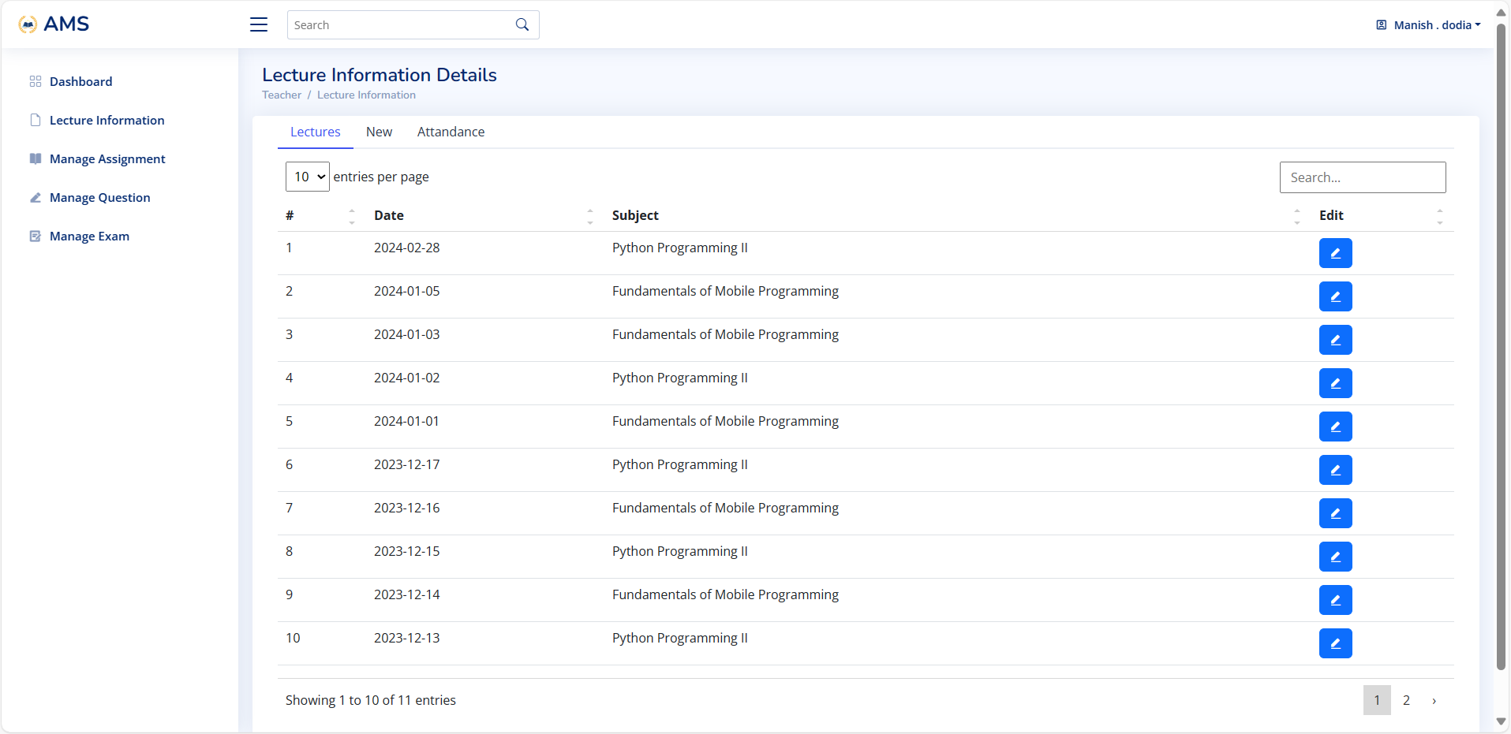

Slide 56
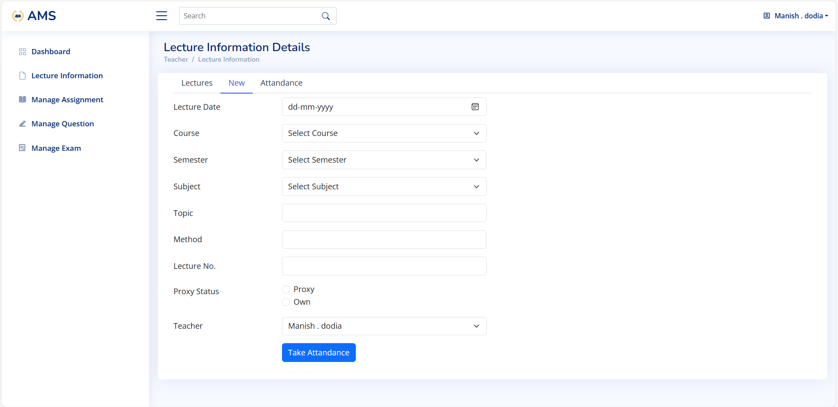

Slide 57
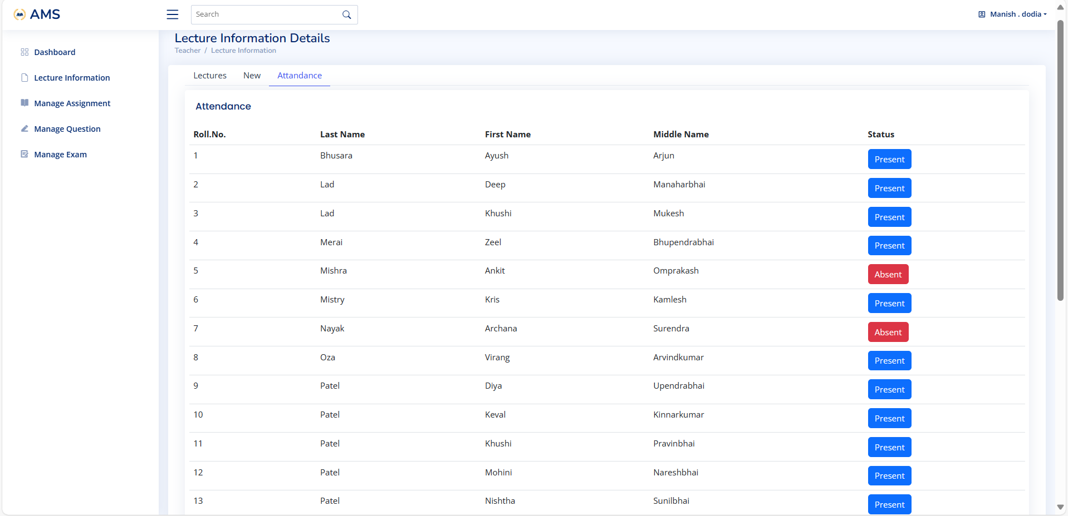

Slide 58
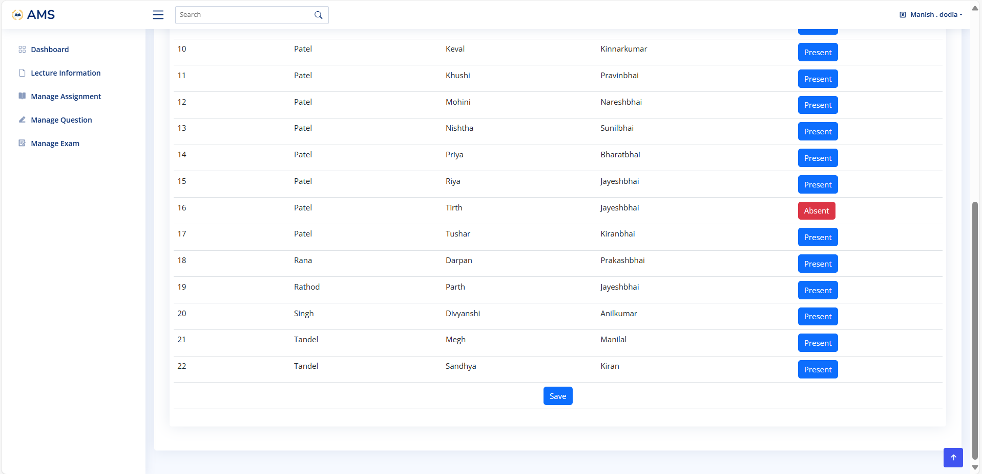

Slide 59


Slide 60
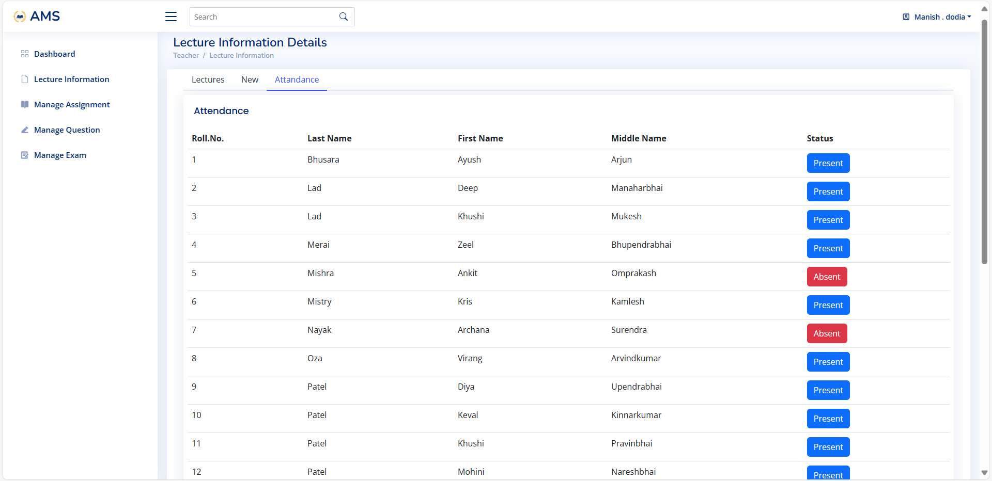

Slide 61
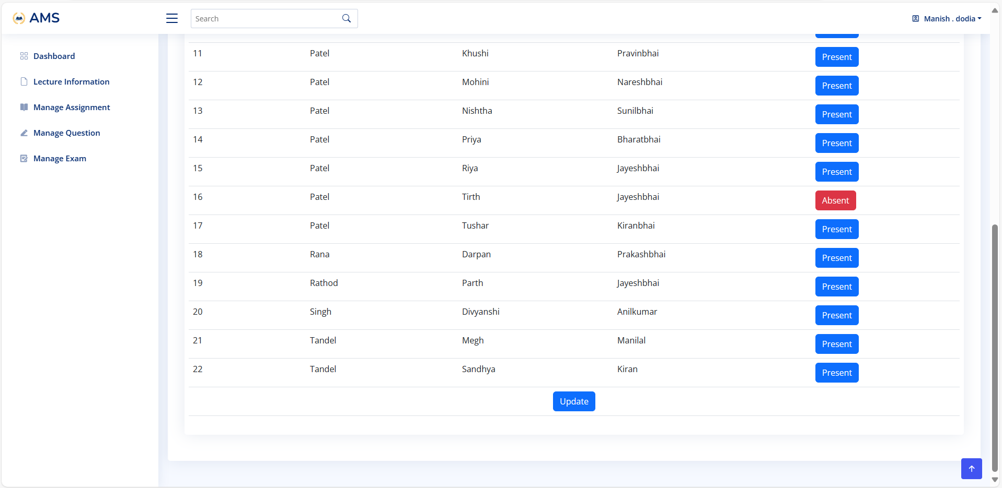

Slide 62
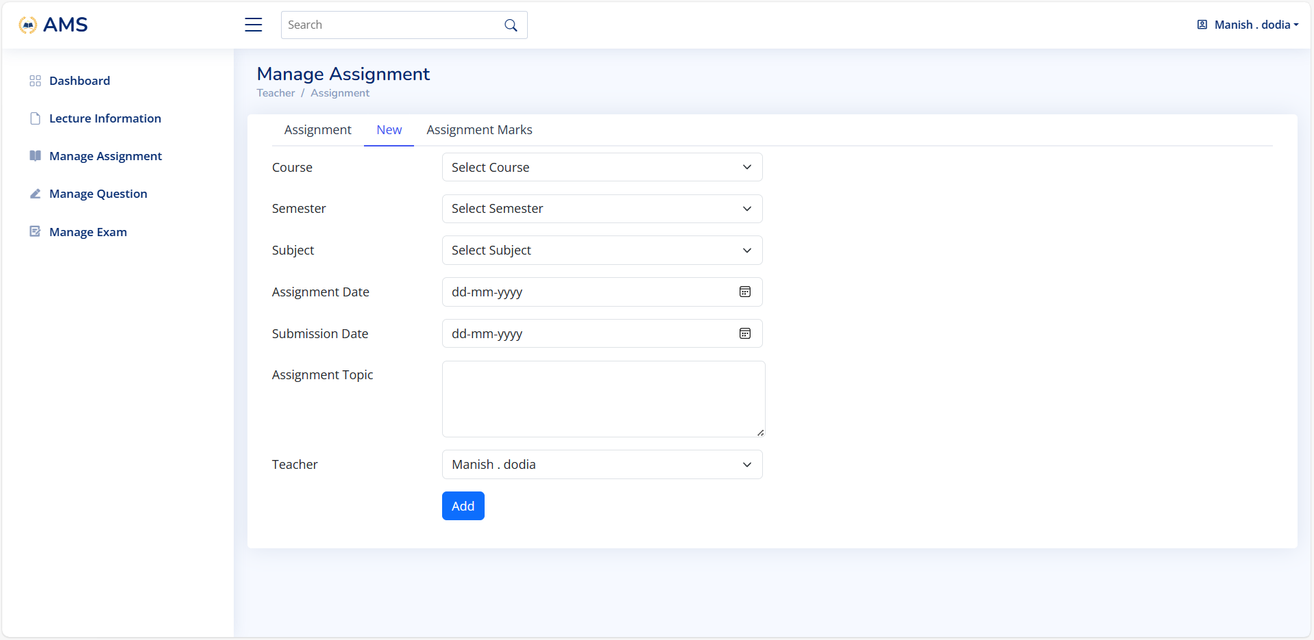

Slide 63
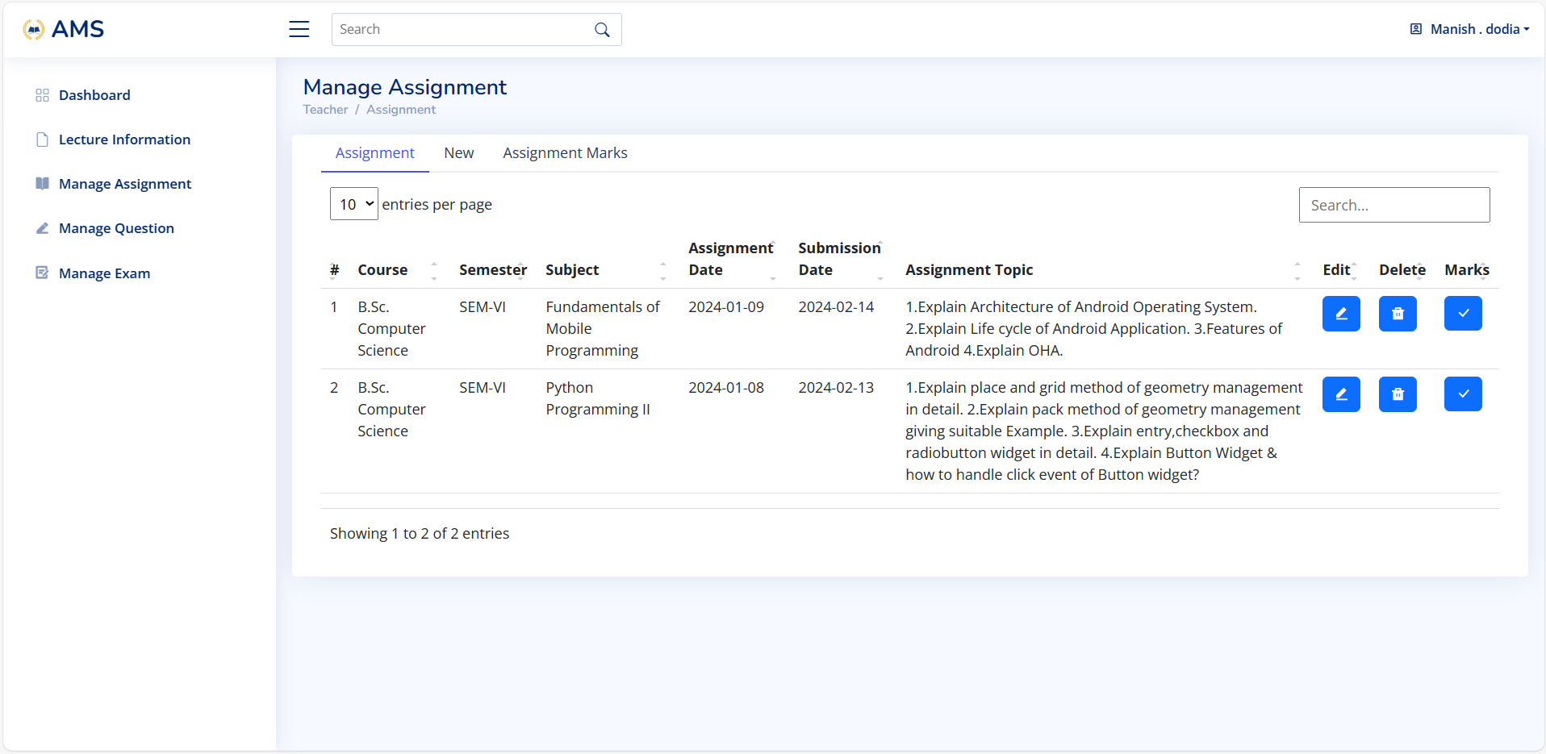

Slide 64
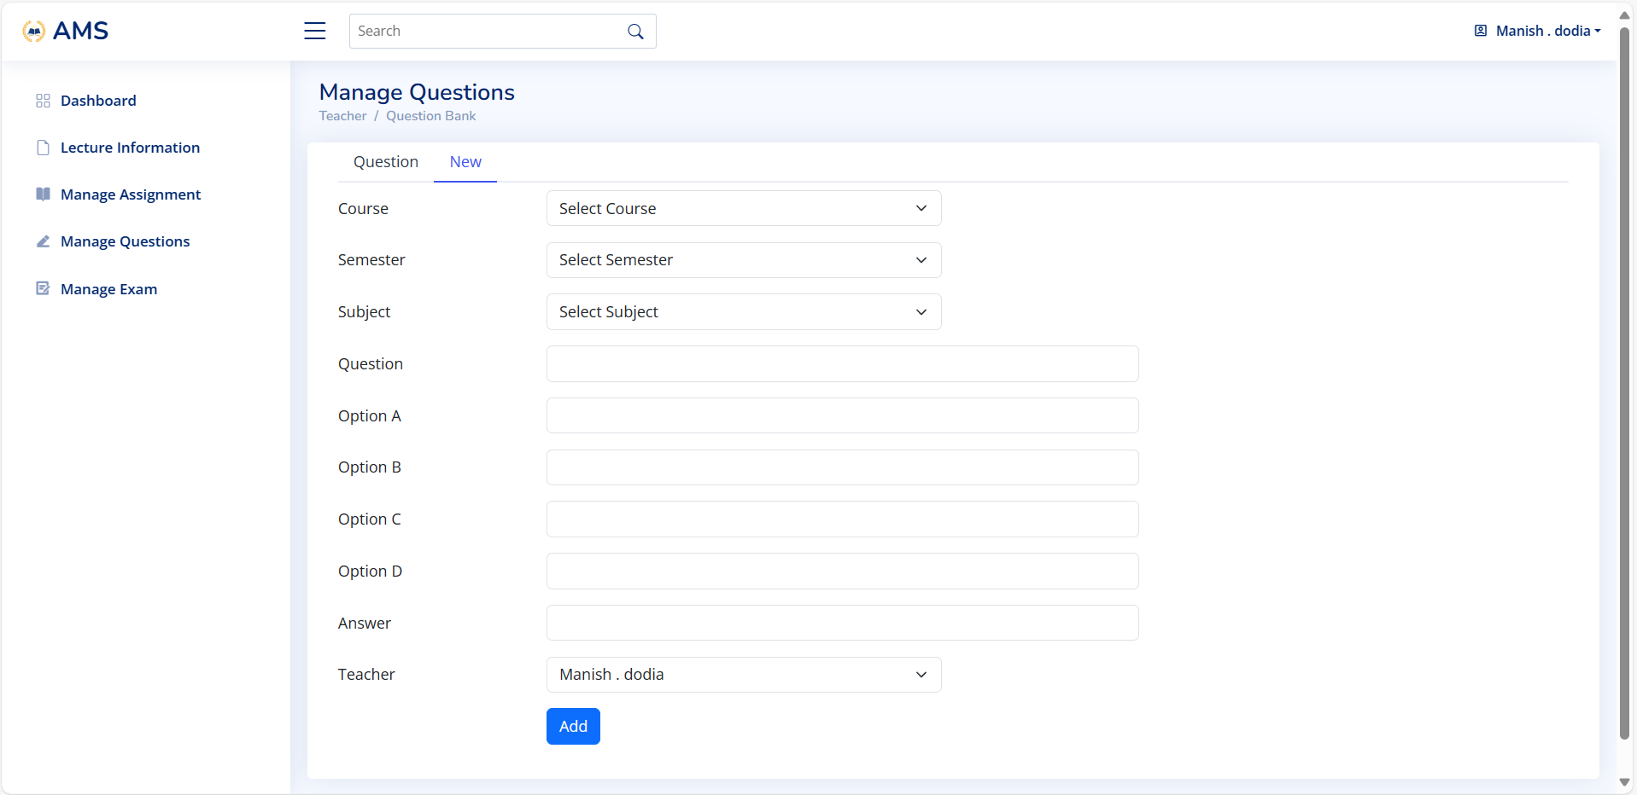

Slide 65
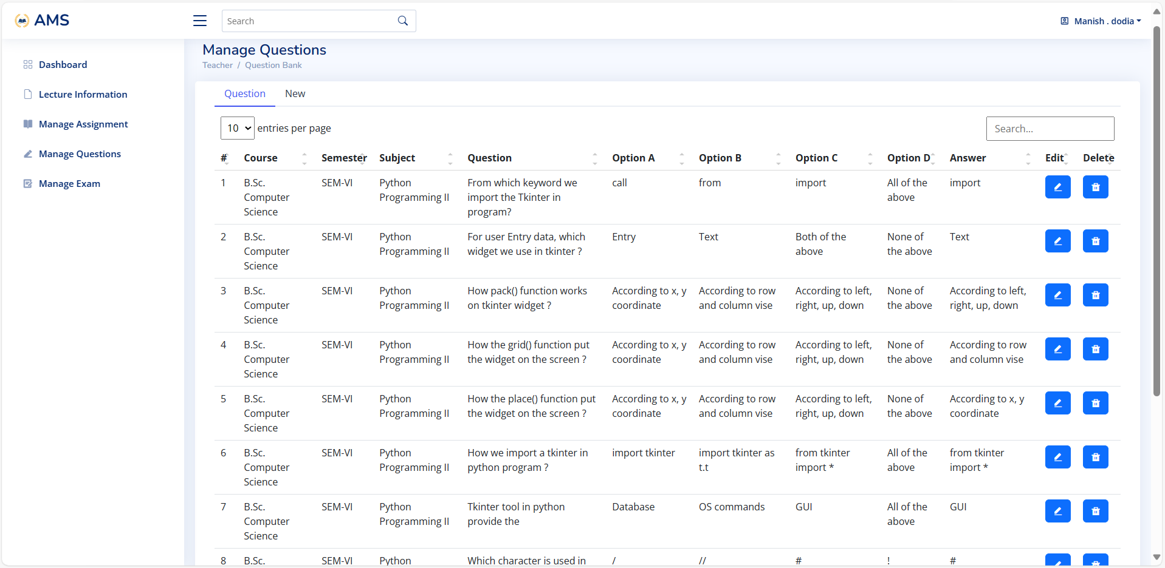

Slide 66
Student Side

Slide 67
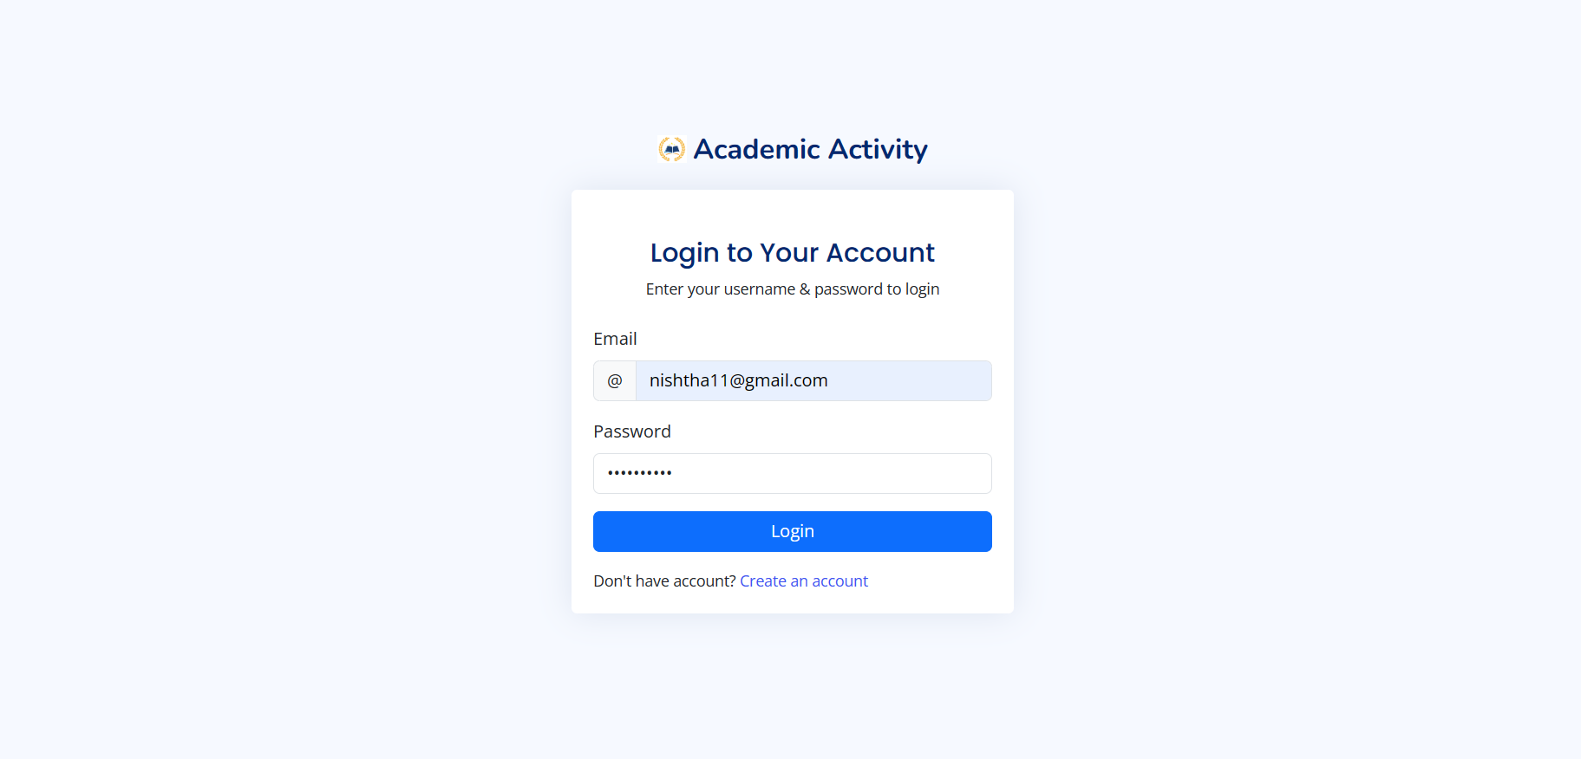

Slide 68
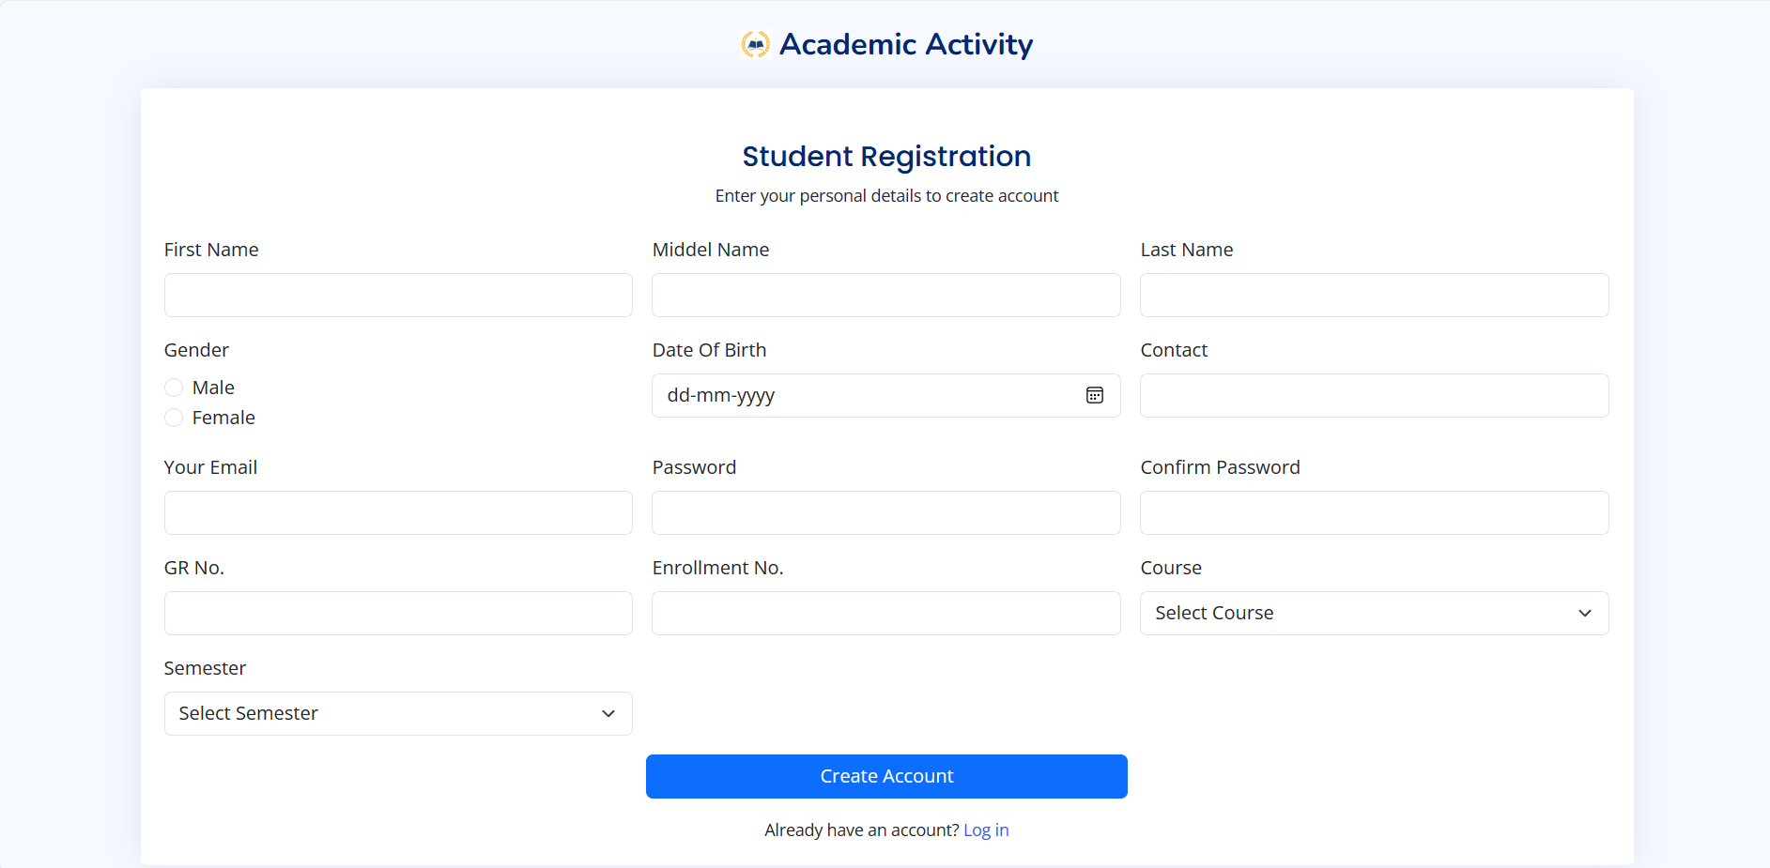

Slide 69
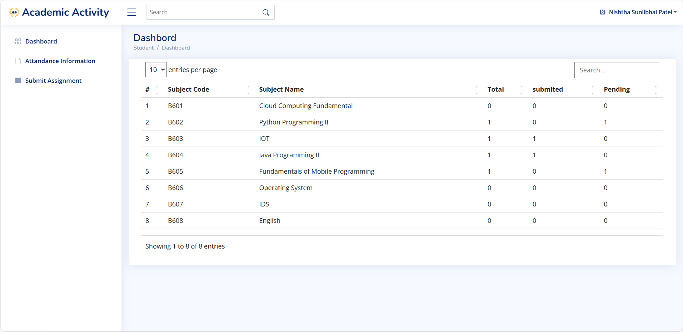

Slide 70
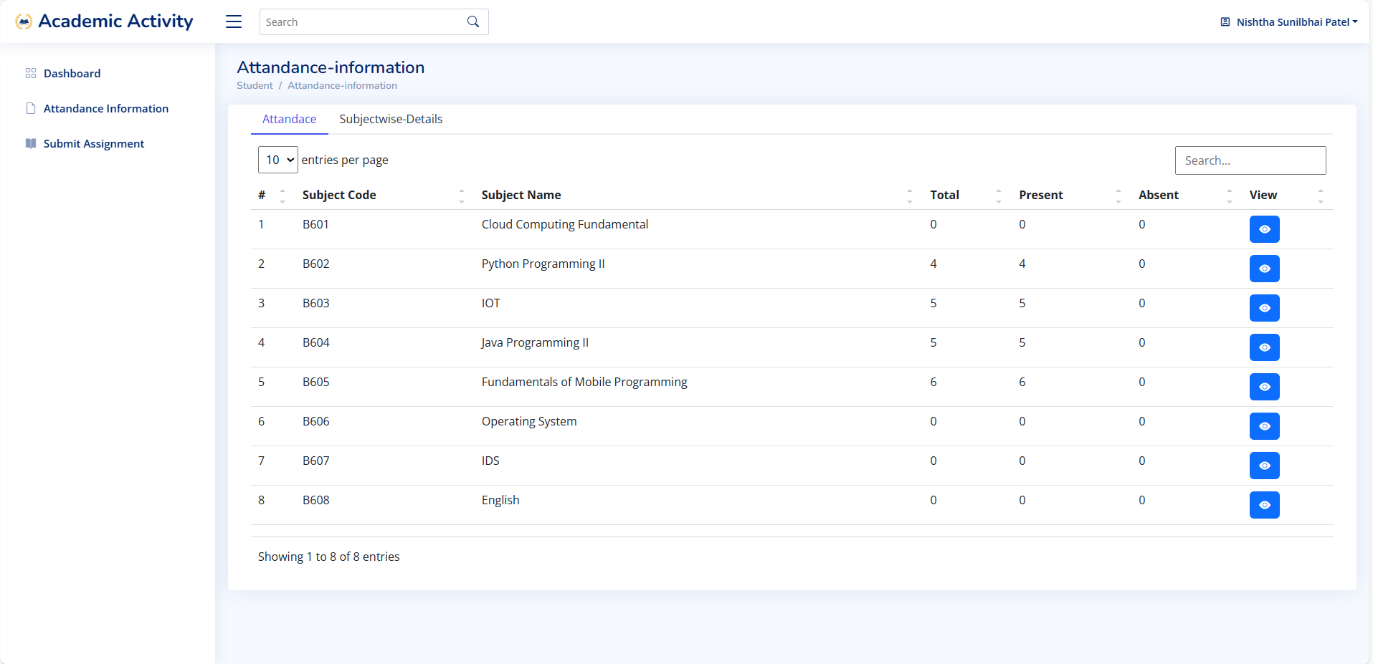

Slide 71
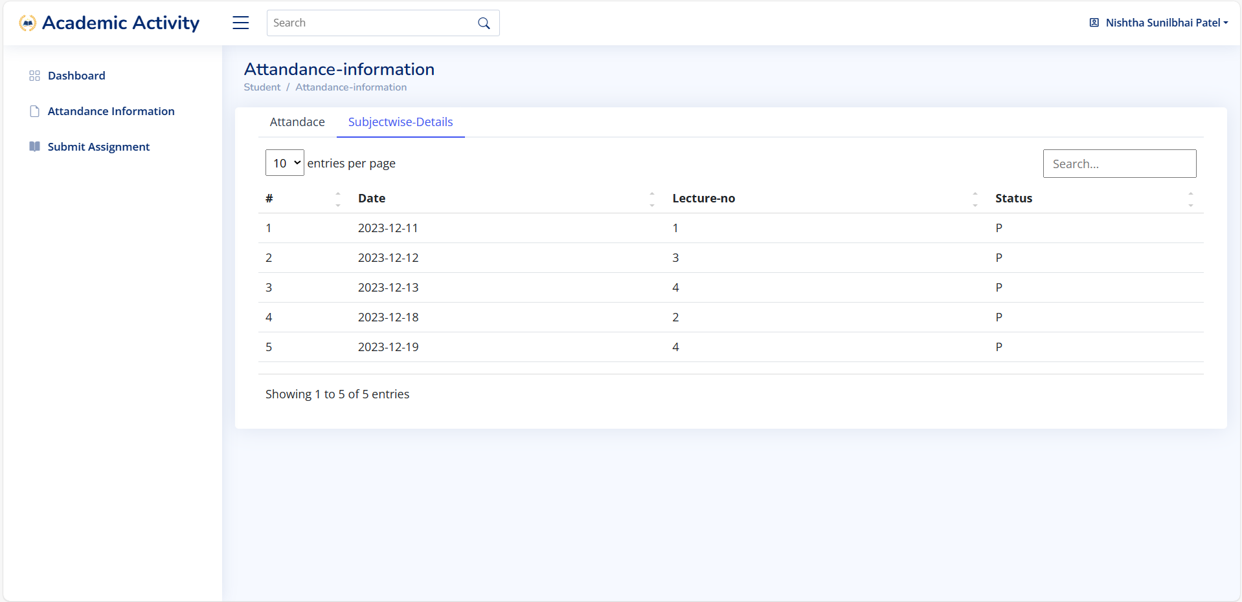

Slide 72
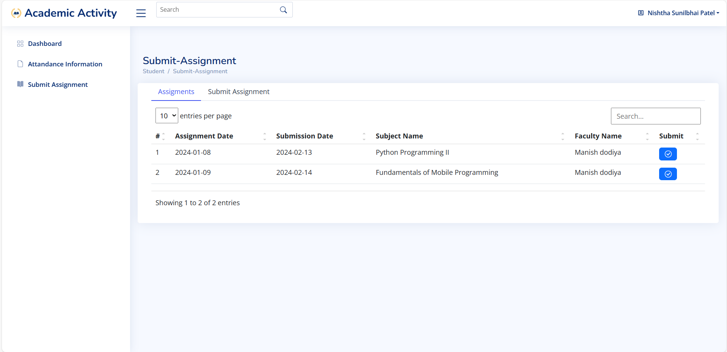

Slide 73
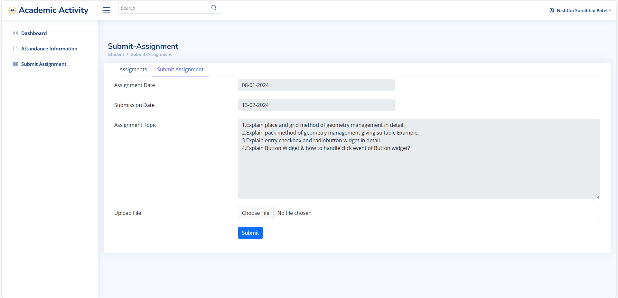

Slide 74
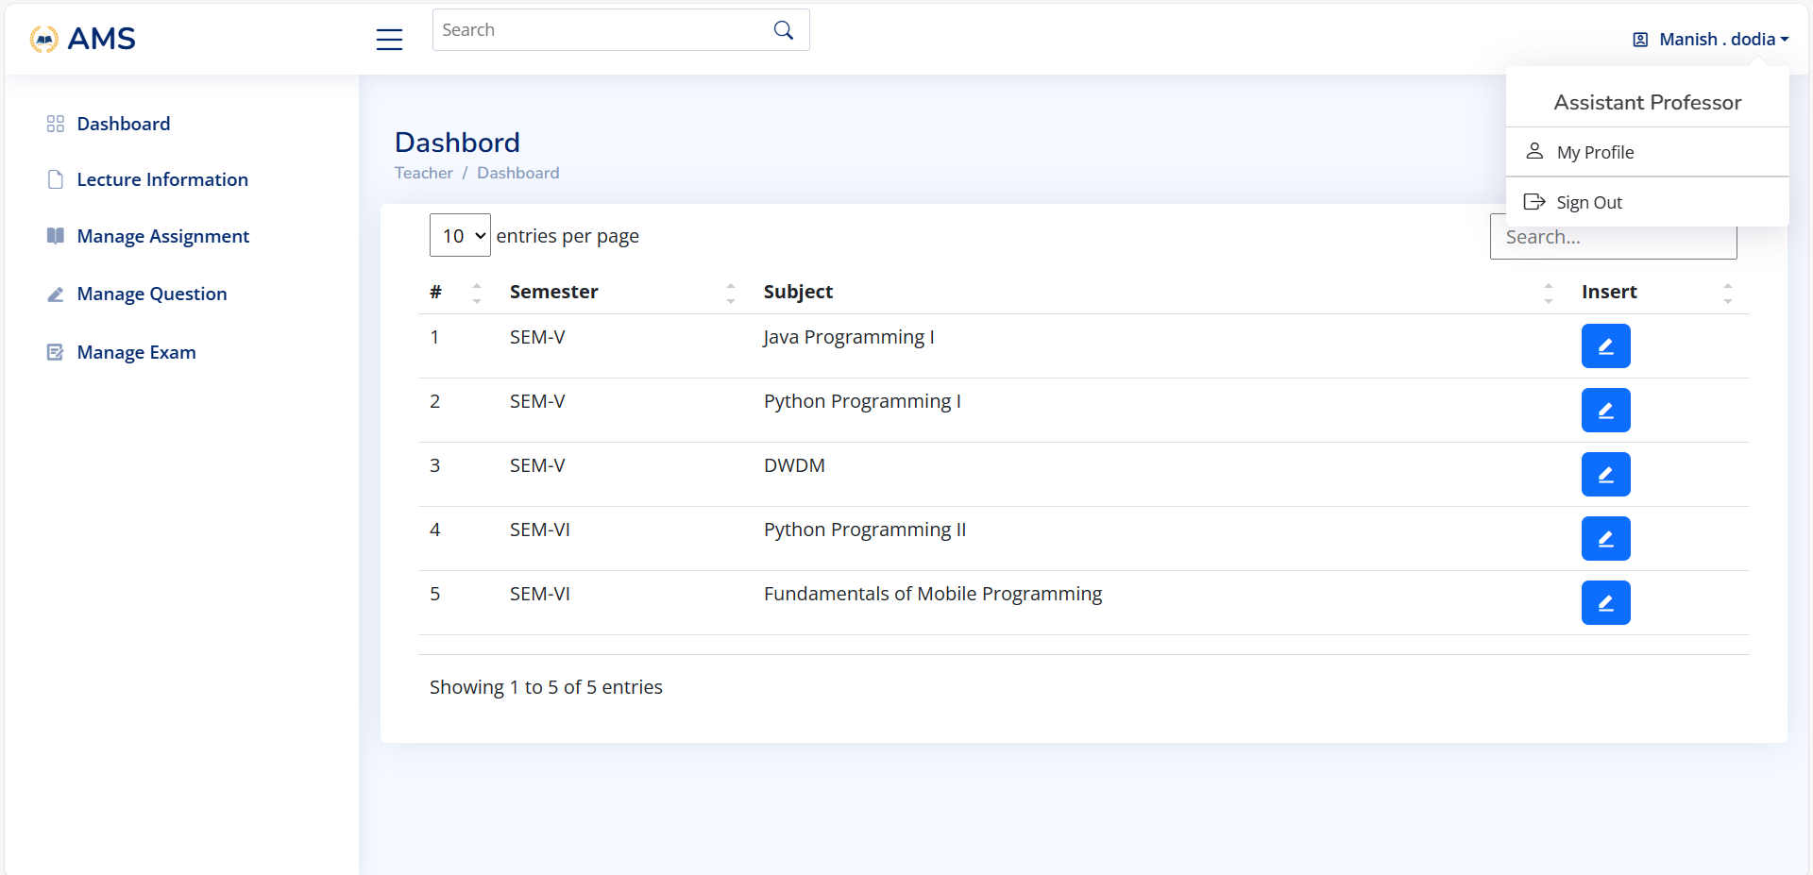

Slide 75
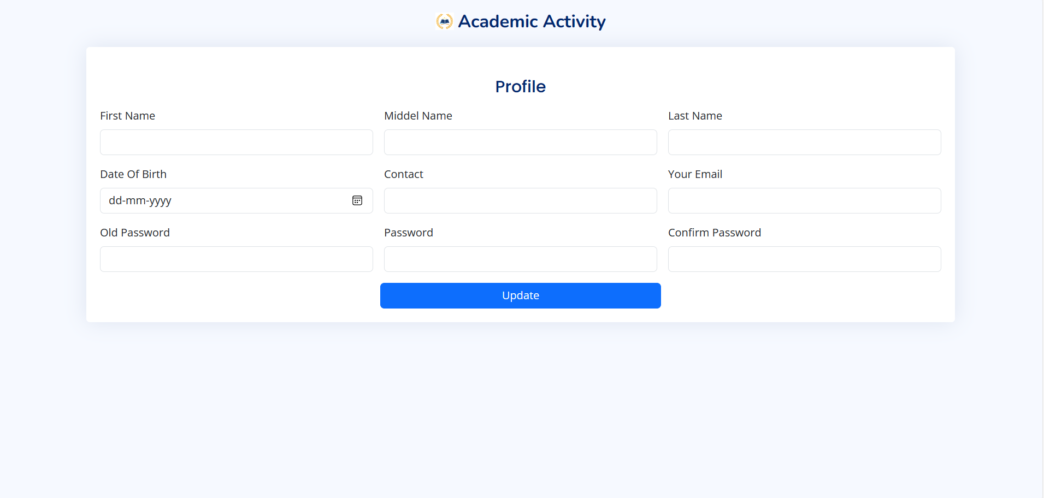

Slide 76
conclusion :-
This online website developed using HTML, PHP and MySQL fulfills the basic objectives of the Academic activity tracking system for which it has been developed. The Academic activity tracking system has easy to maintain for attendance, assignment, questions bank, exam.

Slide 77
Thank You...!!

